Slide 1





Ants
$$\text{Atlantis} \text{and} \text{Plato}\text{′}\text{s} \text{Ratio}$$
Paul McKay Easter
Fairbanks, AK
paul.m.easter@gmail.com
972-474-7501
Archaeological Renaissance: Part I

Slide 2
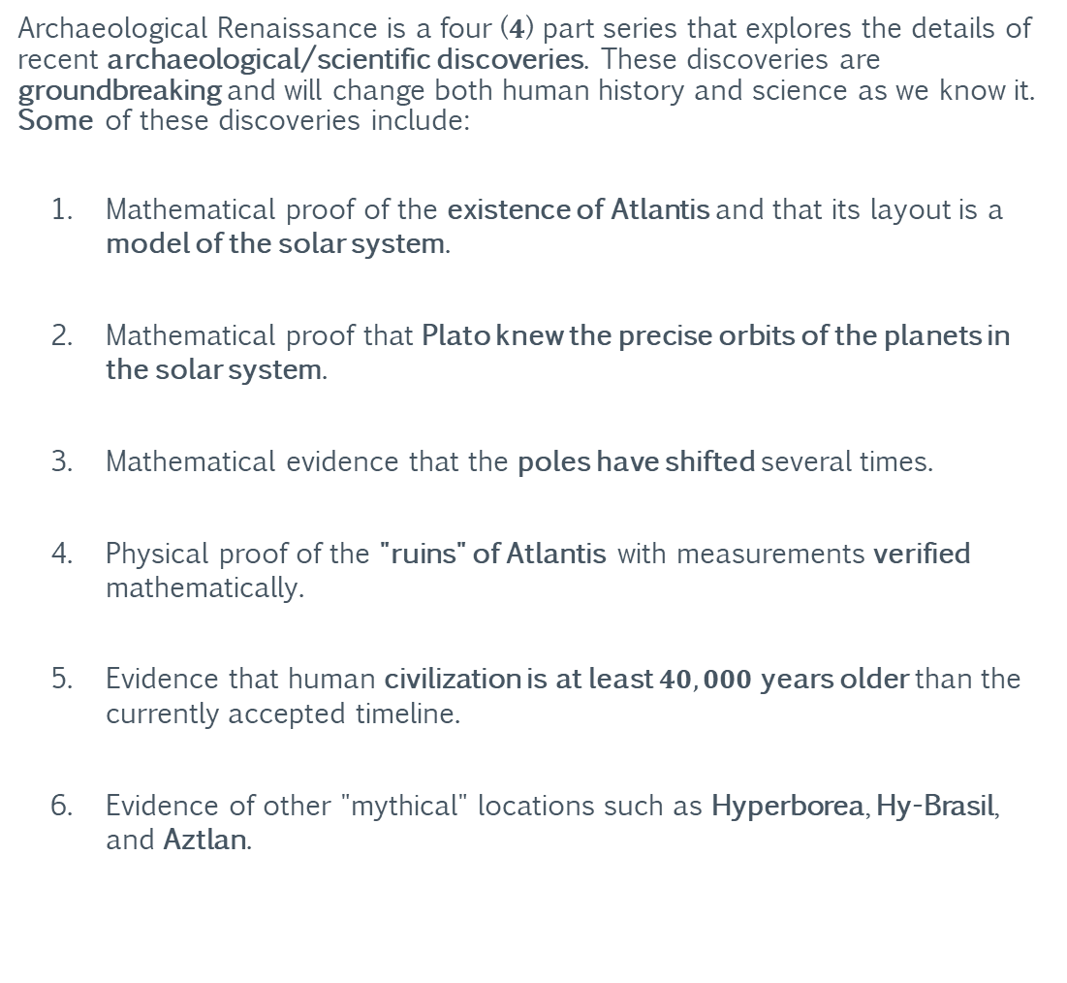
Archaeological Renaissance
Summary
Archaeological Renaissance is a four ($4$) part series that explores the details of recent archaeological/scientific discoveries. These discoveries are groundbreaking and will change both human history and science as we know it. Some of these discoveries include:
Mathematical proof of the existence of Atlantis and that its layout is a model of the solar system.
Mathematical proof that Plato knew the precise orbits of the planets in the solar system.
Mathematical evidence that the poles have shifted several times.
Physical proof of the "ruins" of Atlantis with measurements verified mathematically.
Evidence that human civilization is at least $40,000$years older than the currently accepted timeline.
Evidence of other "mythical" locations such as Hyperborea, Hy-Brasil, and Aztlan.
Part I: Ants
Part II: Pivots
Part III: Projections
Part IV: Frames

Slide 3
Archaeological Renaissance
This Information Shall Remain Free
Grant of Public License
This document is part of a software program. The software program, which includes its documentation, is free: you can redistribute it and/or modify it under the terms of the GNU General Public License as published by the Free Software Foundation, either version 3 of the License, or (at your option) any later version.
This program is distributed in the hope that it will be useful, but without any warranty; without even the implied warranty of merchantability or fitness for a particular purpose. See the GNU General Public License for more details.
You should have received a copy of the GNU General Public License along with this program. If not, see https://www.gnu.org/licenses/.
Part I: Ants
Part II: Pivots
Part III: Projections
Part IV: Frames

Slide 4
Archaeological Renaissance
This Information Shall Remain Free
Grant of Current and Future Patents
All rights to any current and future patents, having derived from any quantity of unique and/or proprietary information contained within the software program, generated by the software program, or derived from the use and/or reverse engineering of the software program are reserved.
All reserved rights of said patents are hereby granted to the public.
Image Copyrights
Some images used in this document were acquired through a public image search engine and their use is covered under United States “fair use” laws for academic/non-commercial distribution. However, some images may be subject to additional copyright(s) and/or commercial redistribution restrictions.
Part I: Ants
Part II: Pivots
Part III: Projections
Part IV: Frames
https://www.dmlp.org/legal-guide/fair-use

Slide 5
For Elaina, Collin, and Arianna: This lost world I’ve found; I rebuild for you.
-Dad

Slide 6
Section 0: Technical Primer
The following section provides an overview of basic mathematical and astronomical concepts. If you are already familiar with these subjects, you can skip to Section I, but it is recommended that you at least skim through this section, as it also provides context for Section I.

Slide 7
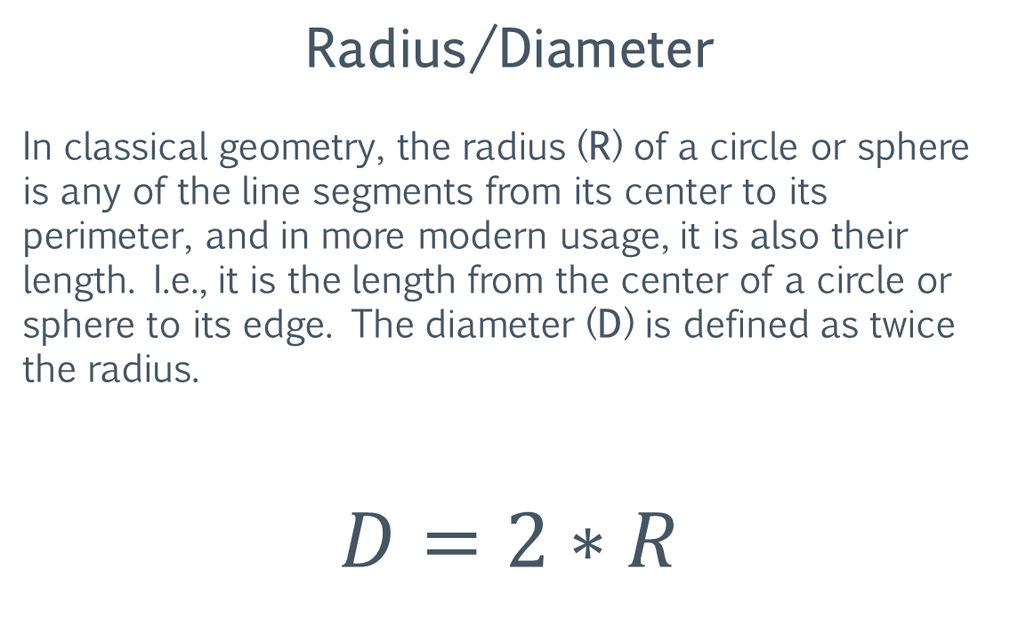
Primer: Mathematical Definitions
Radius/Diameter
In classical geometry, the radius (R) of a circle or sphere is any of the line segments from its center to its perimeter, and in more modern usage, it is also their length. I.e., it is the length from the center of a circle or sphere to its edge. The diameter (D) is defined as twice the radius.
$$D=2∗R$$
https://en.wikipedia.org/wiki/Radius

Slide 8
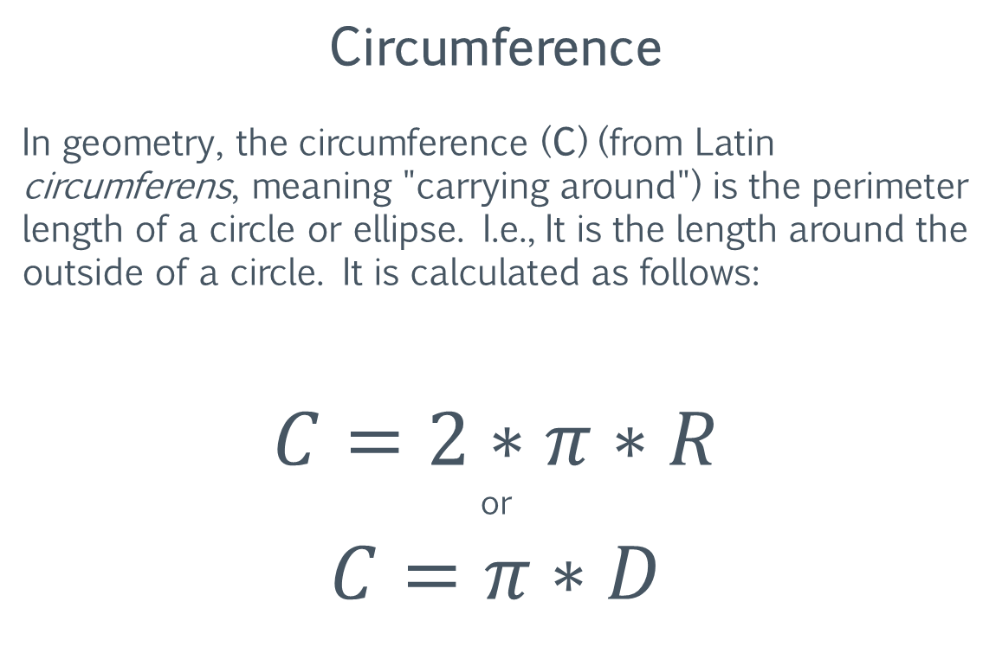
Primer: Mathematical Definitions
Circumference
In geometry, the circumference (C) (from Latin circumferens, meaning "carrying around") is the perimeter length of a circle or ellipse. I.e., It is the length around the outside of a circle. It is calculated as follows:
$$C=2∗π∗R$$
or
$$C=π∗D$$
https://en.wikipedia.org/wiki/Circumference

Slide 9
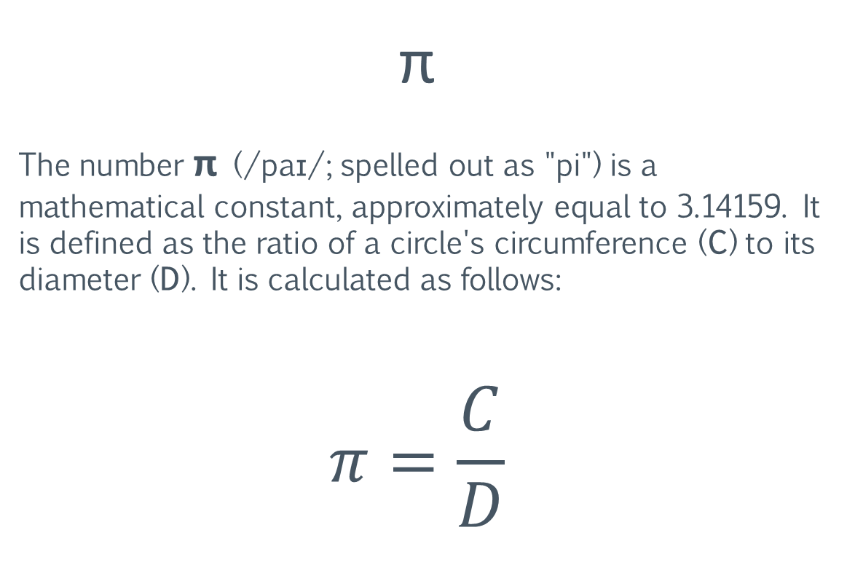
Primer: Mathematical Definitions
π
The number π (/paɪ/; spelled out as "pi") is a mathematical constant, approximately equal to 3.14159. It is defined as the ratio of a circle's circumference (C) to its diameter (D). It is calculated as follows:
$$π=\frac{C}{D}$$
https://en.wikipedia.org/wiki/Pi

Slide 10
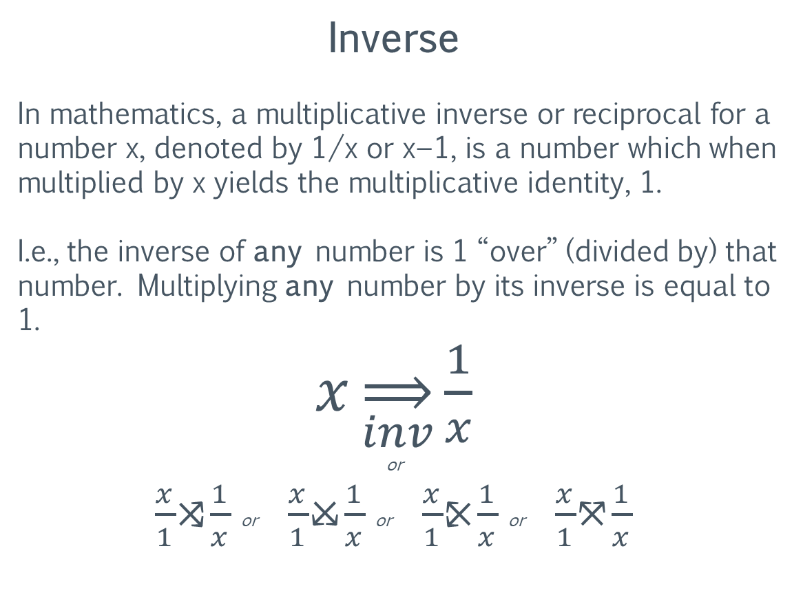
Primer: Mathematical Definitions
Inverse
In mathematics, a multiplicative inverse or reciprocal for a number x, denoted by 1/x or x−1, is a number which when multiplied by x yields the multiplicative identity, 1.
I.e., the inverse of any number is 1 “over” (divided by) that number. Multiplying any number by its inverse is equal to 1.
$x\overset{⇒}{inv}\frac{1}{x}$
or
$\frac{x}{1}$⤨$\frac{1}{x}$ or $\frac{x}{1}$⤩$\frac{1}{x}$ or $\frac{x}{1}$⤪$\frac{1}{x}$ or $\frac{x}{1}$⤧$\frac{1}{x}$
https://en.wikipedia.org/wiki/Multiplicative_inverse

Slide 11

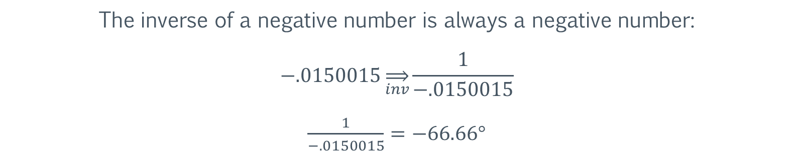
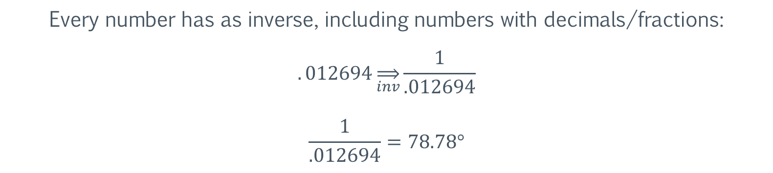
Primer: Mathematical Definitions
Inverse
Every number has as inverse, including numbers with decimals/fractions:
$$.012694\overset{⇒}{inv}\frac{1}{.012694}$$
$$\frac{1}{.012694}=78.78°$$
The inverse of a negative number is always a negative number:
$$−.0150015\overset{⇒}{inv}\frac{1}{−.0150015}$$
$\frac{1}{−.0150015}=−66.66°$
Hyperborea
https://en.wikipedia.org/wiki/Multiplicative_inverse

Slide 12
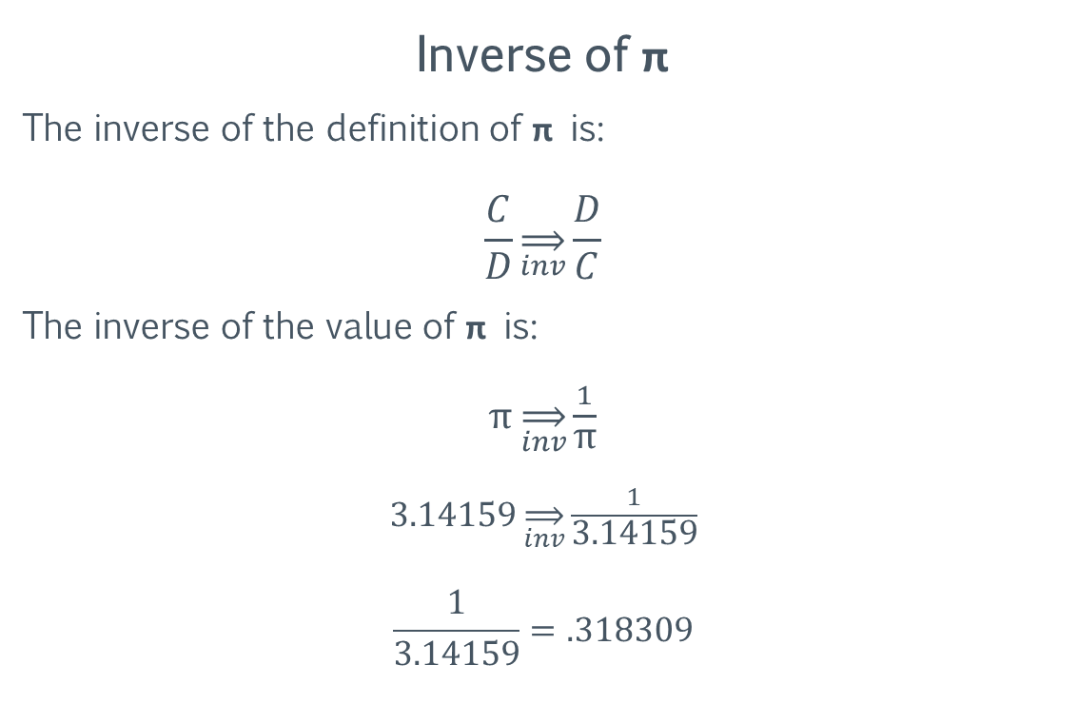
Primer: Mathematical Definitions
Inverse of π
The inverse of the definition of π is:
$$\frac{C}{D}\overset{⇒}{inv}\frac{D}{C}$$
The inverse of the value of π is:
π $\overset{⇒}{inv}\frac{1}{\text{π}}$
3.14159 $\overset{⇒}{inv}\frac{1}{\text{3.14159}}$
$$\frac{1}{3.14159}=.318309$$
https://en.wikipedia.org/wiki/Pi

Slide 13
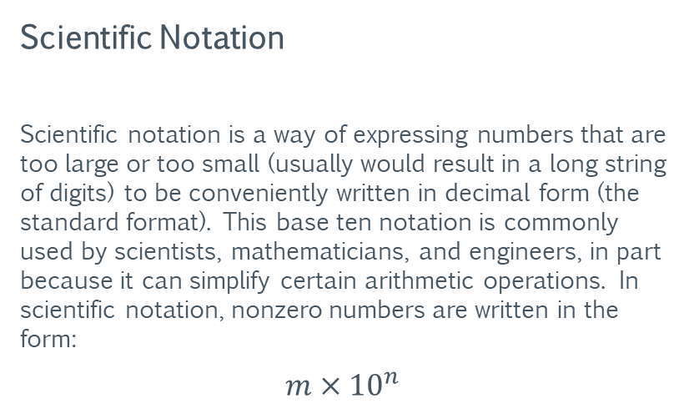
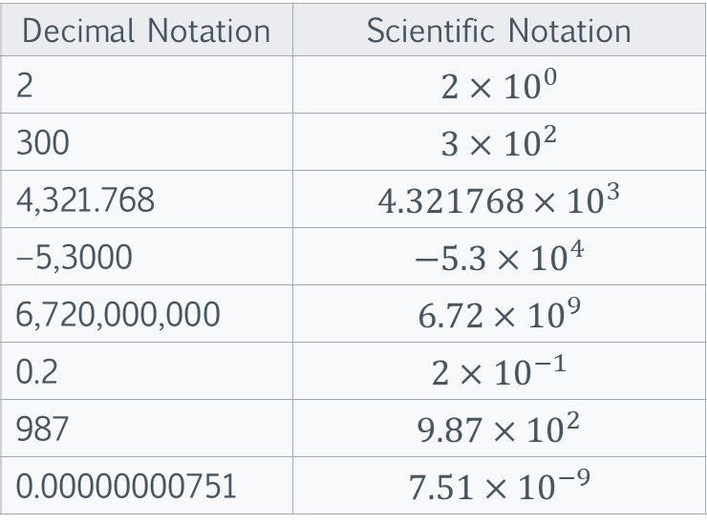
Primer: Mathematical Definitions
Scientific Notation
Scientific notation is a way of expressing numbers that are too large or too small (usually would result in a long string of digits) to be conveniently written in decimal form (the standard format). This base ten notation is commonly used by scientists, mathematicians, and engineers, in part because it can simplify certain arithmetic operations. In scientific notation, nonzero numbers are written in the form:
$$m×{10}^{n}$$
Decimal Notation | Scientific Notation
2 | $$2×{10}^{0}$$
300 | $$3×{10}^{2}$$
4,321.768 | $$4.321768×{10}^{3}$$
−5,3000 | $$−5.3×{10}^{4}$$
6,720,000,000 | $$6.72×{10}^{9}$$
0.2 | $$2×{10}^{−1}$$
987 | $$9.87×{10}^{2}$$
0.00000000751 | $$7.51×{10}^{−9}$$
The table above illustrates decimal notation vs scientific notation.
https://en.wikipedia.org/wiki/Scientific_notation

Slide 14
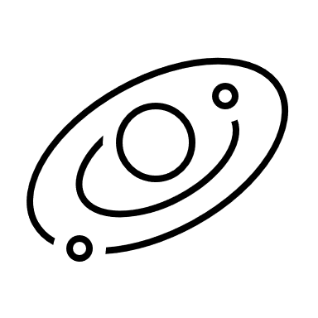
Primer: Astronomy Definitions
Orbit
In celestial mechanics, an orbit is the gravitationally curved trajectory of an object, such as the trajectory of a planet around a star or a natural satellite around a planet. To a close approximation, planets and satellites follow elliptic orbits, with the center of mass being orbited at a focal point of the ellipse, as described by Kepler's laws of planetary motion.
https://en.wikipedia.org/wiki/Orbit

Slide 15
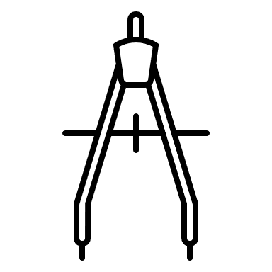
Primer: Astronomy Definitions
Orbital Radius
In celestial mechanics, the orbital radius is the distance from the center of mass of the Sun to the center of mass of the planet. Although it could be the radius of any one celestial body orbiting another (such as the Moon around the Earth). Since most orbits are elliptical, an orbit will be comprised of a maximum orbital radius, a minimum orbital radius, and the corresponding average orbital radius. The average orbital radius is the orbital component used to determine the orbital period.
https://en.wikipedia.org/wiki/Orbital_mechanics

Slide 16

Primer: Astronomy Definitions
Orbital Period
The orbital period (also revolution period) is the time a given astronomical object takes to complete one orbit around another object and applies in astronomy usually to planets or asteroids orbiting the Sun, moons orbiting planets, exoplanets orbiting other stars, or binary stars. For celestial objects in general, the sidereal orbital period (sidereal year) is referred to by the orbital period, determined by a 360° revolution of one celestial body around another, e.g., the Earth orbiting the Sun, relative to the fixed stars projected in the sky.
https://en.wikipedia.org/wiki/Orbital_period

Slide 17
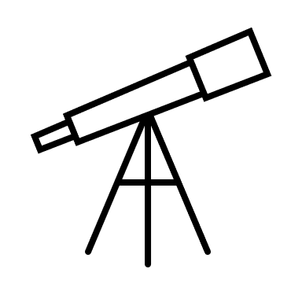
Primer: Astronomy Definitions
Astronomical Unit
The astronomical unit (symbol: au, or au or AU) is a unit of length equal to Earth’s average orbital radius. It is equal to about 150 million kilometers (93 million miles). The astronomical unit is used primarily for measuring distances within the Solar System or around other stars.
https://en.wikipedia.org/wiki/Astronomical_unit

Slide 18
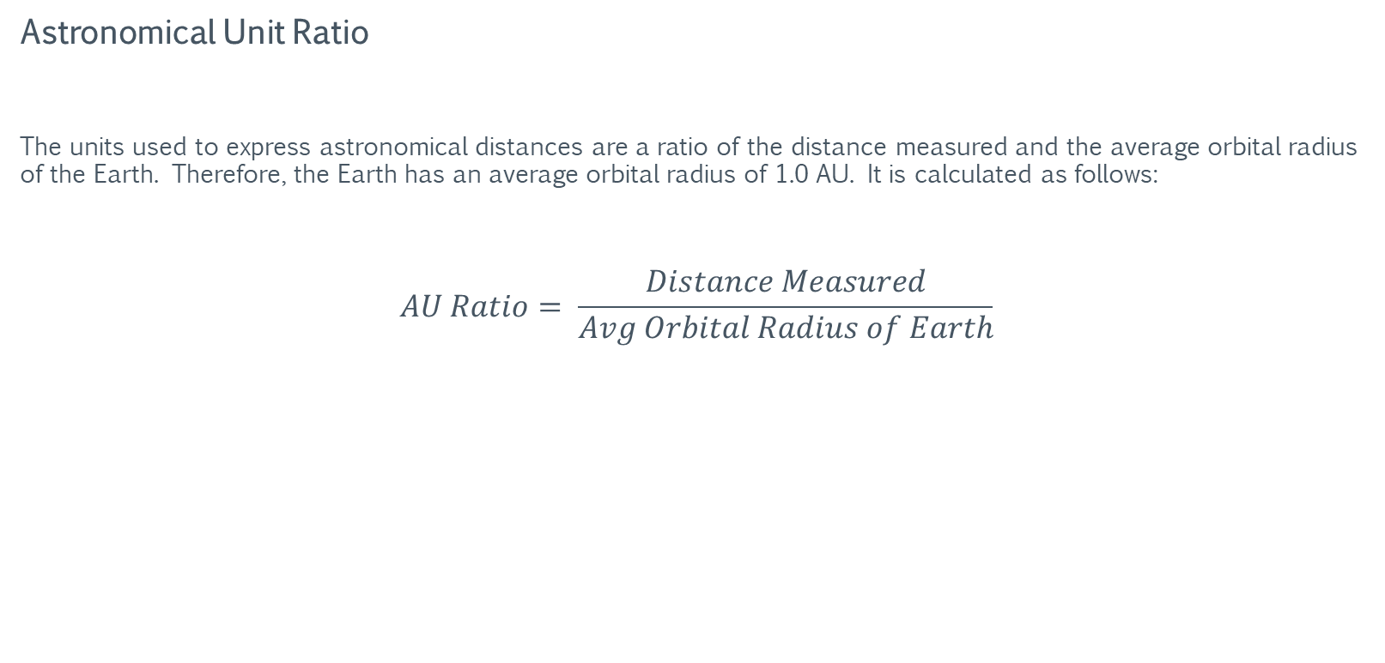
Primer: Astronomy Definitions
Astronomical Unit Ratio
The units used to express astronomical distances are a ratio of the distance measured and the average orbital radius of the Earth. Therefore, the Earth has an average orbital radius of 1.0 AU. It is calculated as follows:
$$AU Ratio= \frac{Distance Measured}{Avg Orbital Radius of Earth}$$
https://en.wikipedia.org/wiki/Astronomical_unit

Slide 19
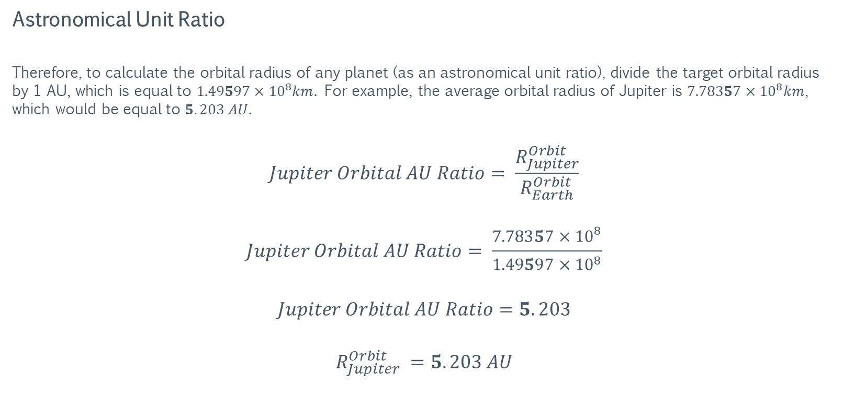
Primer: Astronomy Definitions
Astronomical Unit Ratio
Therefore, to calculate the orbital radius of any planet (as an astronomical unit ratio), divide the target orbital radius by 1 AU, which is equal to $1.49597×{10}^{8}km$. For example, the average orbital radius of Jupiter is $7.78357×{10}^{8}km$, which would be equal to $5.203 AU$.
$$Jupiter Orbital AU Ratio= \frac{R_{Jupiter}^{Orbit}}{R_{Earth}^{Orbit}}$$
$$Jupiter Orbital AU Ratio= \frac{7.78357×{10}^{8}}{1.49597×{10}^{8}}$$
$$Jupiter Orbital AU Ratio=5.203$$
$$R_{Jupiter}^{Orbit} =5.203 AU$$
https://en.wikipedia.org/wiki/Astronomical_unit

Slide 20
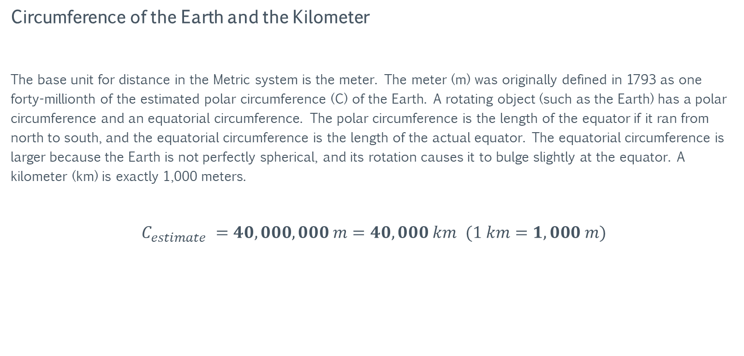
Primer: Astronomy Definitions
Circumference of the Earth and the Kilometer
The base unit for distance in the Metric system is the meter. The meter (m) was originally defined in 1793 as one forty-millionth of the estimated polar circumference (C) of the Earth. A rotating object (such as the Earth) has a polar circumference and an equatorial circumference. The polar circumference is the length of the equator if it ran from north to south, and the equatorial circumference is the length of the actual equator. The equatorial circumference is larger because the Earth is not perfectly spherical, and its rotation causes it to bulge slightly at the equator. A kilometer (km) is exactly 1,000 meters.
$C_{estimate} =40,000,000 m=40,000 km$ $(1 km=1,000 m)$
https://en.wikipedia.org/wiki/Earth%27s_circumference

Slide 21
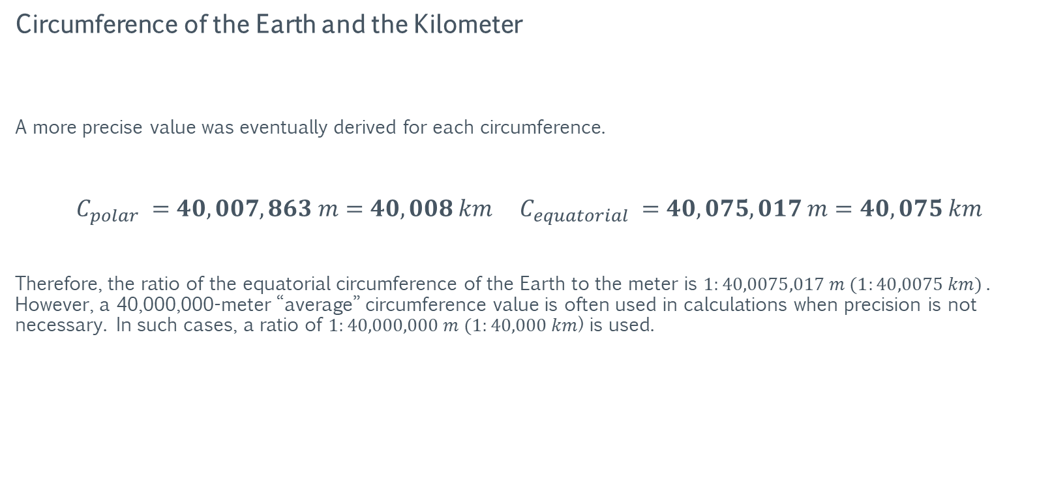
Primer: Astronomy Definitions
Circumference of the Earth and the Kilometer
A more precise value was eventually derived for each circumference.
$$C_{polar} =40,007,863 m=40,008 km{ C}_{equatorial} =40,075,017 m=40,075 km$$
Therefore, the ratio of the equatorial circumference of the Earth to the meter is $1:40,0075,017 m (1:40,0075 km)$. However, a 40,000,000-meter “average” circumference value is often used in calculations when precision is not necessary. In such cases, a ratio of $1:40,000,000 m (1:40,000 km$) is used.
https://en.wikipedia.org/wiki/Earth%27s_circumference

Slide 22

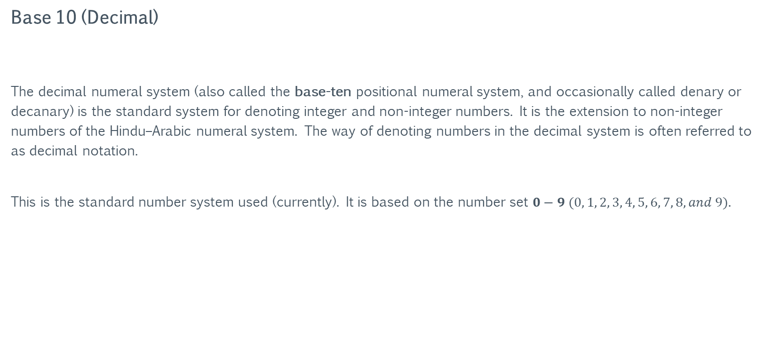
Primer: Number Systems
Base 10 (Decimal)
The decimal numeral system (also called the base-ten positional numeral system, and occasionally called denary or decanary) is the standard system for denoting integer and non-integer numbers. It is the extension to non-integer numbers of the Hindu–Arabic numeral system. The way of denoting numbers in the decimal system is often referred to as decimal notation.
This is the standard number system used (currently). It is based on the number set $0−9 (0, 1, 2, 3, 4, 5, 6, 7, 8, and 9).$
https://en.wikipedia.org/wiki/Decimal

Slide 23
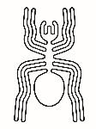
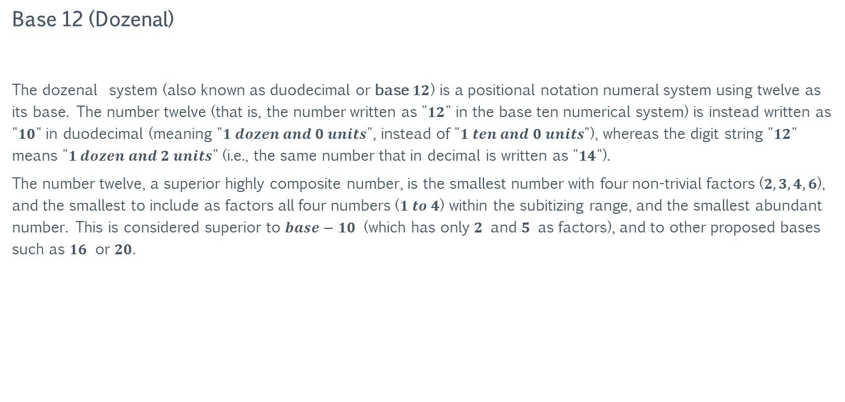
Primer: Number Systems
Base 12 (Dozenal)
The dozenal system (also known as duodecimal or base $12$) is a positional notation numeral system using twelve as its base. The number twelve (that is, the number written as "$12$" in the base ten numerical system) is instead written as "$10$" in duodecimal (meaning "$1 dozen and 0 units$", instead of "$1 ten and 0 units$"), whereas the digit string "$12$" means "$1 dozen and 2 units$" (i.e., the same number that in decimal is written as "$14$").
The number twelve, a superior highly composite number, is the smallest number with four non-trivial factors ($2, 3, 4, 6$), and the smallest to include as factors all four numbers ($1 to 4$) within the subitizing range, and the smallest abundant number. This is considered superior to $base−10$ (which has only $2$ and $5$ as factors), and to other proposed bases such as $16$ or $20$.
https://en.wikipedia.org/wiki/Duodecimal

Slide 24
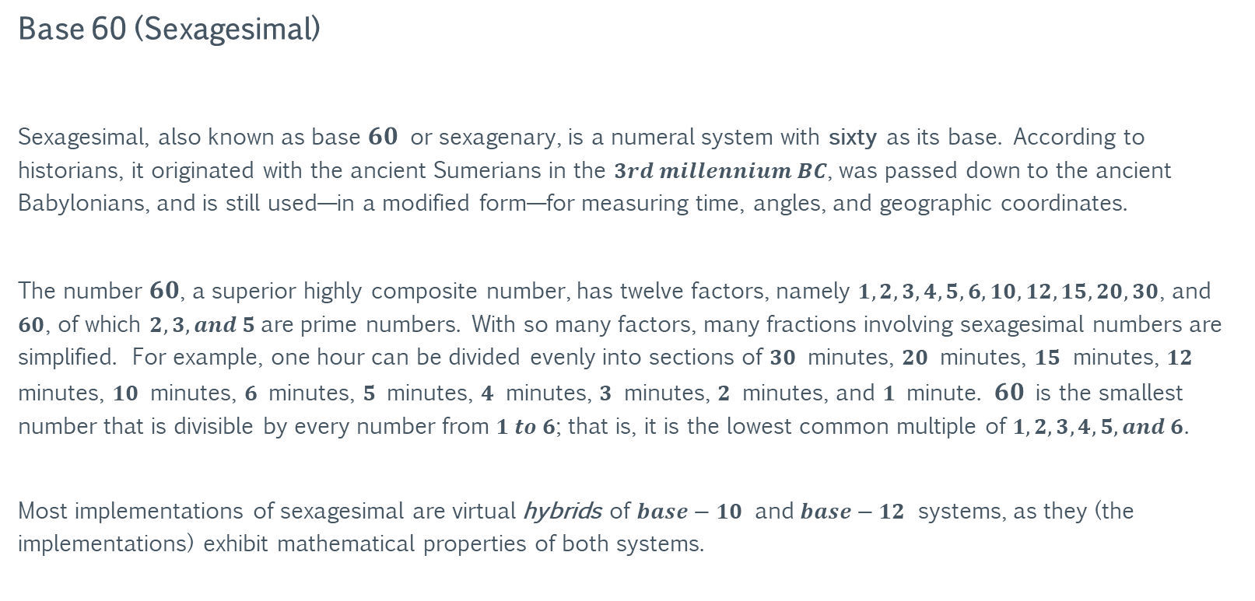
Primer: Number Systems
Base 60 (Sexagesimal)
Sexagesimal, also known as base $60$ or sexagenary, is a numeral system with sixty as its base. According to historians, it originated with the ancient Sumerians in the $3rd millennium BC$, was passed down to the ancient Babylonians, and is still used—in a modified form—for measuring time, angles, and geographic coordinates.
The number $60$, a superior highly composite number, has twelve factors, namely $1, 2, 3, 4, 5, 6, 10, 12, 15, 20, 30$, and $60$, of which $2, 3, and 5$are prime numbers. With so many factors, many fractions involving sexagesimal numbers are simplified. For example, one hour can be divided evenly into sections of $30$ minutes, $20$ minutes, $15$ minutes, $12$ minutes, $10$ minutes, $6$ minutes, $5$ minutes, $4$ minutes, $3$ minutes, $2$ minutes, and $1$ minute. $60$ is the smallest number that is divisible by every number from $1 to 6$; that is, it is the lowest common multiple of $1, 2, 3, 4, 5, and 6$.
Most implementations of sexagesimal are virtual hybrids of $base−10$ and $base−12$ systems, as they (the implementations) exhibit mathematical properties of both systems.
https://en.wikipedia.org/wiki/Sexagesimal

Slide 25
Section I: Atlantis & Plato’s Ratio
The following section examines Plato’s description of Atlantis and compares its measurements to the orbital distances of the planets of the solar system.

Slide 26
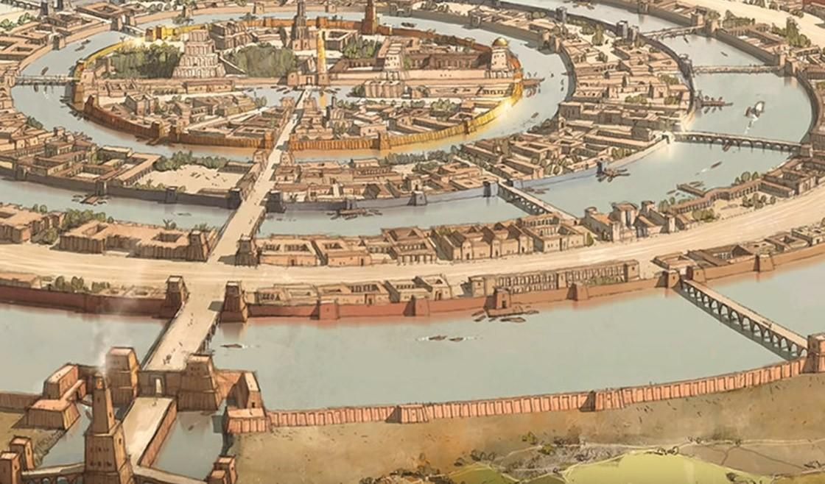
Atlantis & Plato’s Ratio
Atlantis
Atlantis (Ancient Greek: “Island of Atlas") is an island mentioned in an allegory on the hubris of nations in Plato's works Timaeus and Critias, wherein it represents the antagonist naval power that besieges "Ancient Athens", the pseudo-historic embodiment of Plato's ideal state in The Republic.
In the story, Athens repels the Atlantean attack unlike any other nation of the known world, supposedly bearing witness to the superiority of Plato's concept of a state.
The story concludes with Atlantis falling out of favor with the deities and submerging into the Atlantic Ocean.
https://en.wikipedia.org/wiki/Atlantis

Slide 27
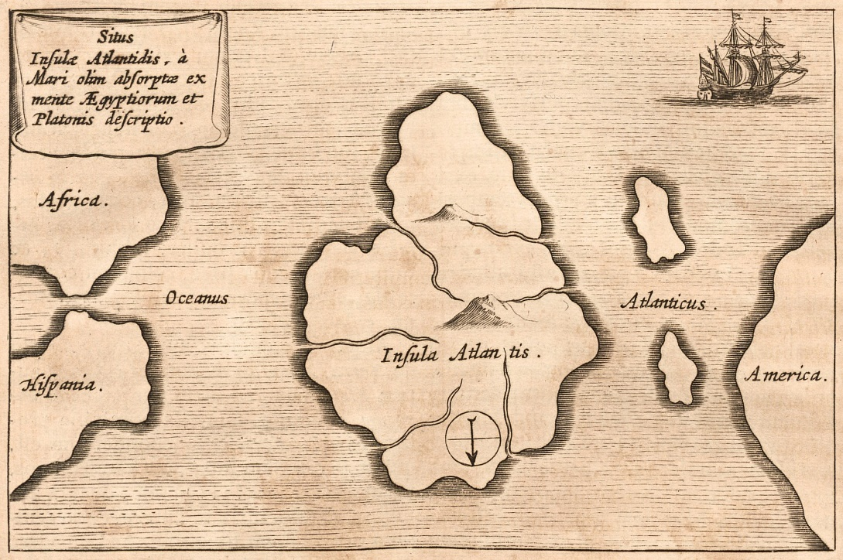
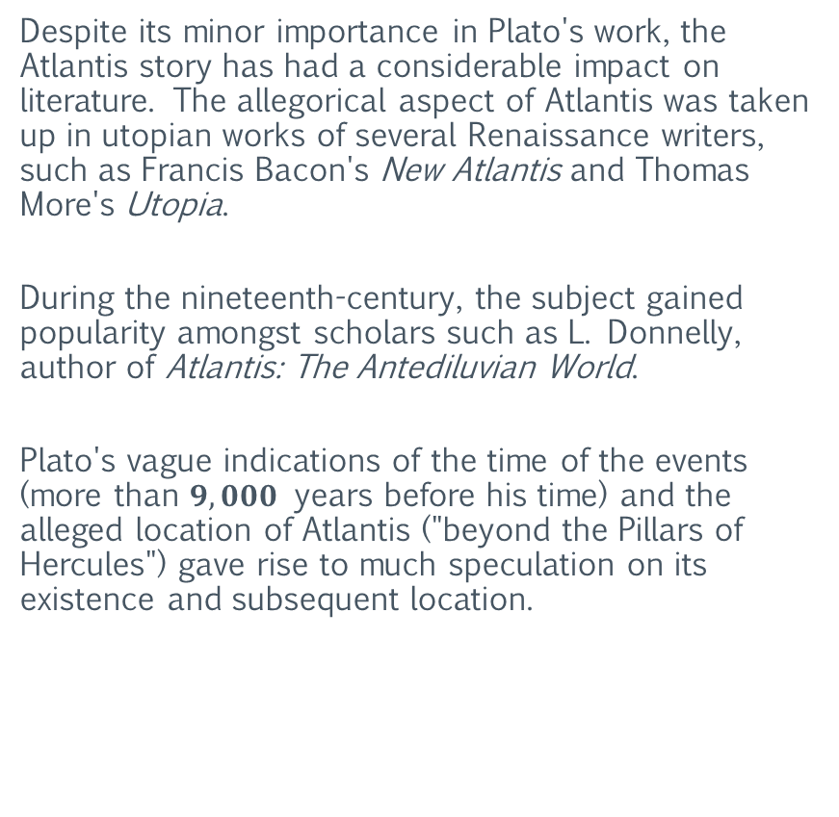
Atlantis & Plato’s Ratio
Atlantis
Despite its minor importance in Plato's work, the Atlantis story has had a considerable impact on literature. The allegorical aspect of Atlantis was taken up in utopian works of several Renaissance writers, such as Francis Bacon's New Atlantis and Thomas More's Utopia.
During the nineteenth-century, the subject gained popularity amongst scholars such as L. Donnelly, author of Atlantis: The Antediluvian World.
Plato's vague indications of the time of the events (more than $9,000$ years before his time) and the alleged location of Atlantis ("beyond the Pillars of Hercules") gave rise to much speculation on its existence and subsequent location.
https://en.wikipedia.org/wiki/Atlantis

Slide 28
Atlantis & Plato’s Ratio
Plato’s Description of Atlantis
The layout of the zones of Atlantis.

Slide 29
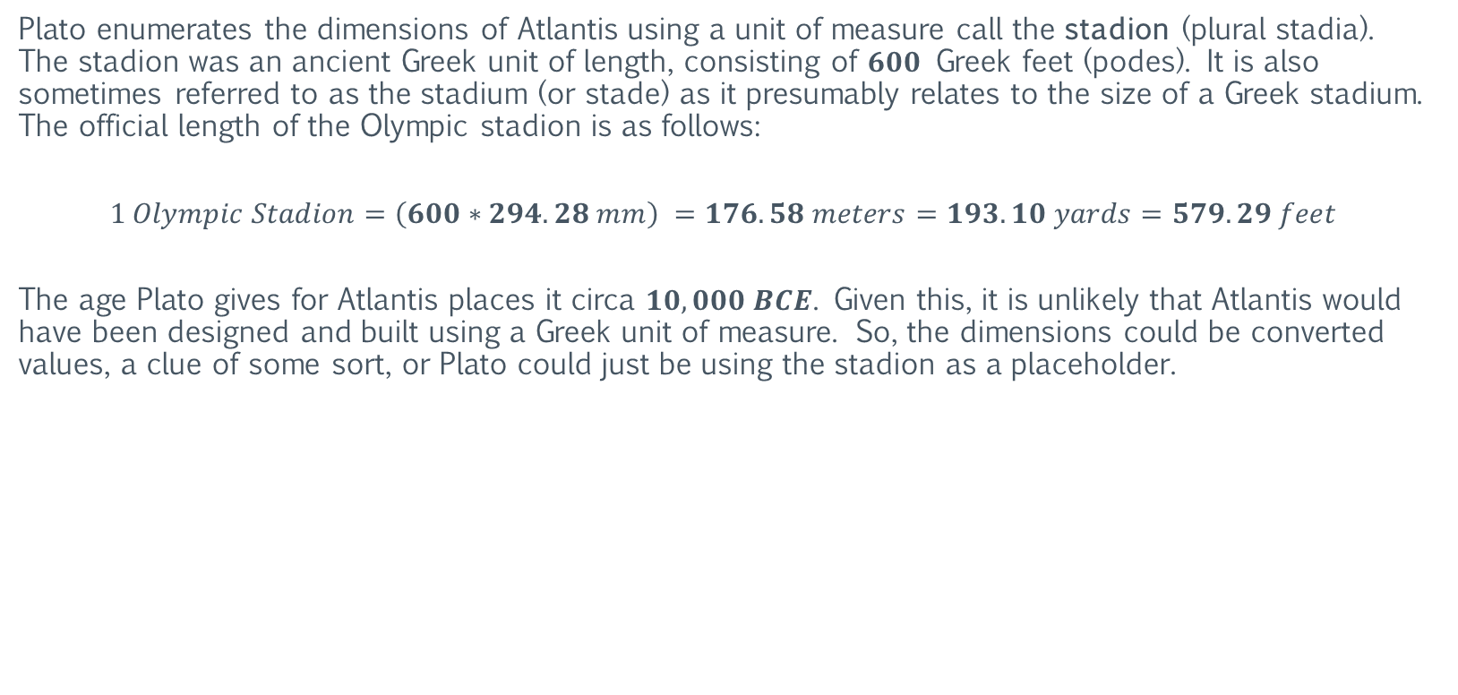
Atlantis & Plato’s Ratio
Plato’s Description of Atlantis: The Stadion (Stadia)
Plato enumerates the dimensions of Atlantis using a unit of measure call the stadion (plural stadia). The stadion was an ancient Greek unit of length, consisting of $600$ Greek feet (podes). It is also sometimes referred to as the stadium (or stade) as it presumably relates to the size of a Greek stadium. The official length of the Olympic stadion is as follows:
$$1 Olympic Stadion=\left(600∗294.28 mm\right) =176.58 meters=193.10 yards=579.29 feet$$
The age Plato gives for Atlantis places it circa $10,000 BCE$. Given this, it is unlikely that Atlantis would have been designed and built using a Greek unit of measure. So, the dimensions could be converted values, a clue of some sort, or Plato could just be using the stadion as a placeholder.
https://en.wikipedia.org/wiki/Stadion_(unit)

Slide 30

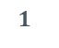

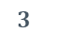
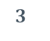
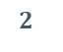
Atlantis & Plato’s Ratio
Plato’s Description of Atlantis
$$5$$
$$1$$
$$2$$
$$2$$
$$3$$
$$3$$
The layout of the zones of Atlantis.
The breadth of each zone (in stadia)

Slide 31
Atlantis & Plato’s Ratio
Plato’s Description of Atlantis
Plato states that Atlantis was created by a god named Poseidon for his mortal bride, Cleito.
For her, he “enclosed the hill in which she dwelt all round, making alternate zones of sea and land larger and smaller, encircling one another; there were two of land and three of water, which he turned as with a lathe, each having its circumference equidistant every way from the center”.
Zone | Plato’s Description
Center Island | “The island in which the palace was situated had a diameter of five stadia”.
Zone 1 (Water) | “…the one which surrounded the central island was a [one] stadium only [in breadth]”.
Zone 2 (Land) | “…the next two zones, the one of water, the other of land, were two stadia [in breadth]”.
Zone 3 (Water) | “…the next two zones, the one of water, the other of land, were two stadia [in breadth]”.
Zone 4 (Land) | “…the largest of the zones…was three stadia in breadth, and the zone of land which came next of equal breadth”.
Zone 5 (Water) | “…the largest of the zones…was three stadia in breadth, and the zone of land which came next of equal breadth”.
Sea Wall | “.. a wall which began at the sea and went all round: this was everywhere distant fifty stadia from the largest zone or harbour”.

Slide 32
Atlantis & Plato’s Ratio
Plato’s Description of Atlantis
Plato goes on to describe the island where Atlantis is located, how the land was divided amongst the ten princes (sons of Poseidon and Cleito), and then provides an abridged genealogy of the “family of the ten princes”.
Zone | Plato’s Description
Center Island | “The island in which the palace was situated had a diameter of five stadia”.
Zone 1 (Water) | “…the one which surrounded the central island was a [one] stadium only [in breadth]”.
Zone 2 (Land) | “…the next two zones, the one of water, the other of land, were two stadia [in breadth]”.
Zone 3 (Water) | “…the next two zones, the one of water, the other of land, were two stadia [in breadth]”.
Zone 4 (Land) | “…the largest of the zones…was three stadia in breadth, and the zone of land which came next of equal breadth”.
Zone 5 (Water) | “…the largest of the zones…was three stadia in breadth, and the zone of land which came next of equal breadth”.
Sea Wall | “.. a wall which began at the sea and went all round: this was everywhere distant fifty stadia from the largest zone or harbour”.

Slide 33
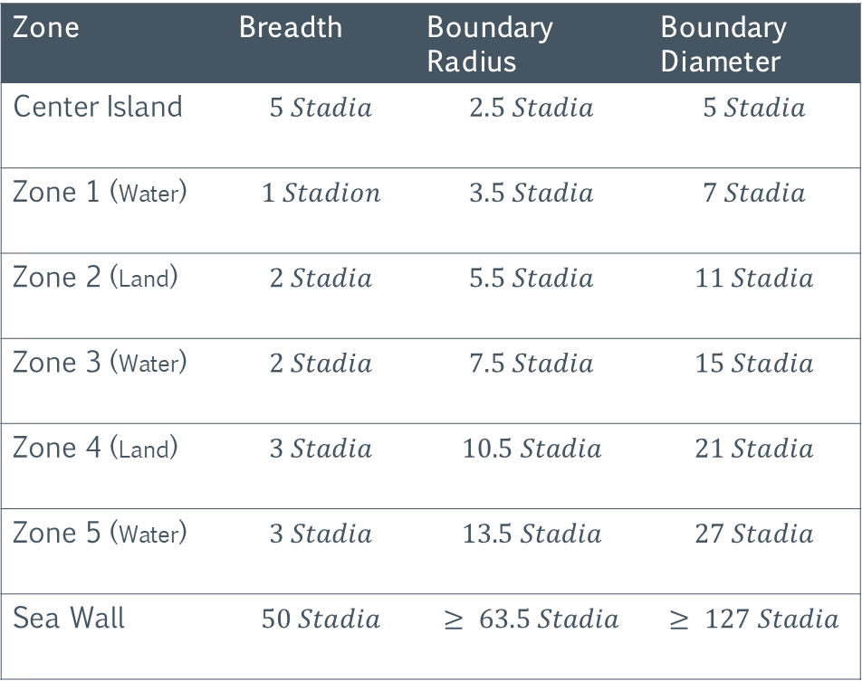
Atlantis & Plato’s Ratio
Plato gives the following measurements for the city of Atlantis
Plato states that “beginning from the sea they bored a canal…which they carried through to the outermost zone, making a passage from the sea up to this, which became a harbour”.
This means that the last zone of water was “cut” open to connect it to the sea. Doing so created a harbor starting from this last zone. Since it is not possible to determine where a zone of water ends, and a sea harbor begins, cutting open the last zone increased its breadth.
Zone | Breadth | Boundary Radius | Boundary Diameter
Center Island | $$5 Stadia$$ | $$2.5 Stadia$$ | $$5 Stadia$$
Zone 1 (Water) | $$1 Stadion$$ | $$3.5 Stadia$$ | $$7 Stadia$$
Zone 2 (Land) | $$2 Stadia$$ | $$5.5 Stadia$$ | $$11 Stadia$$
Zone 3 (Water) | $$2 Stadia$$ | $$7.5 Stadia$$ | $$15 Stadia$$
Zone 4 (Land) | $$3 Stadia$$ | $$10.5 Stadia$$ | $$21 Stadia$$
Zone 5 (Water) | $$3 Stadia$$ | $$13.5 Stadia$$ | $$27 Stadia$$
Sea Wall | $$50 Stadia$$ | $$≥ 63.5 Stadia$$ | $$≥ 127 Stadia$$

Slide 34
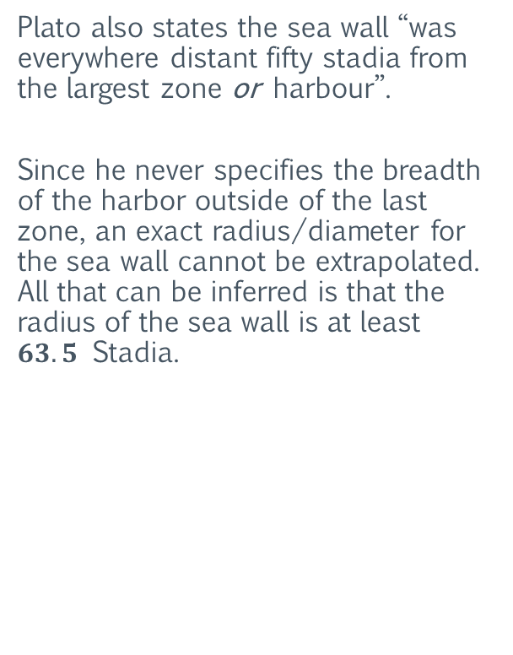
Atlantis & Plato’s Ratio
Plato gives the following measurements for the city of Atlantis
Plato also states the sea wall “was everywhere distant fifty stadia from the largest zone or harbour”.
Since he never specifies the breadth of the harbor outside of the last zone, an exact radius/diameter for the sea wall cannot be extrapolated. All that can be inferred is that the radius of the sea wall is at least $63.5$ Stadia.
Zone | Breadth | Boundary Radius | Boundary Diameter
Center Island | $$5 Stadia$$ | $$2.5 Stadia$$ | $$5 Stadia$$
Zone 1 (Water) | $$1 Stadion$$ | $$3.5 Stadia$$ | $$7 Stadia$$
Zone 2 (Land) | $$2 Stadia$$ | $$5.5 Stadia$$ | $$11 Stadia$$
Zone 3 (Water) | $$2 Stadia$$ | $$7.5 Stadia$$ | $$15 Stadia$$
Zone 4 (Land) | $$3 Stadia$$ | $$10.5 Stadia$$ | $$21 Stadia$$
Zone 5 (Water) | $$3 Stadia$$ | $$13.5 Stadia$$ | $$27 Stadia$$
Sea Wall | $$50 Stadia$$ | $$≥ 63.5 Stadia$$ | $$≥ 127 Stadia$$

Slide 35
Atlantis & Plato’s Ratio
Plato’s Description of Atlantis
Atlantis
The orbital layout of the inner planets of the solar system

Slide 36
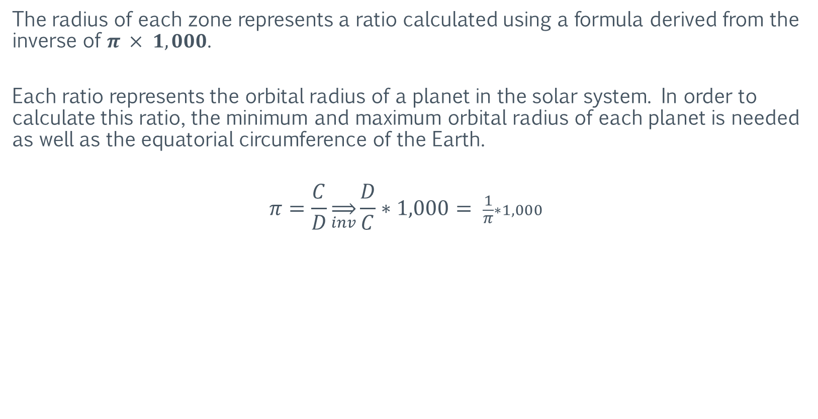
Atlantis & Plato’s Ratio
Atlantis represents a scale model of the solar system
The radius of each zone represents a ratio calculated using a formula derived from the inverse of $π × 1,000$.
Each ratio represents the orbital radius of a planet in the solar system. In order to calculate this ratio, the minimum and maximum orbital radius of each planet is needed as well as the equatorial circumference of the Earth.
$$π=\frac{C}{D}\overset{⇒}{inv}\frac{D}{C}∗1,000= \frac{1}{π}∗1,000$$

Slide 37
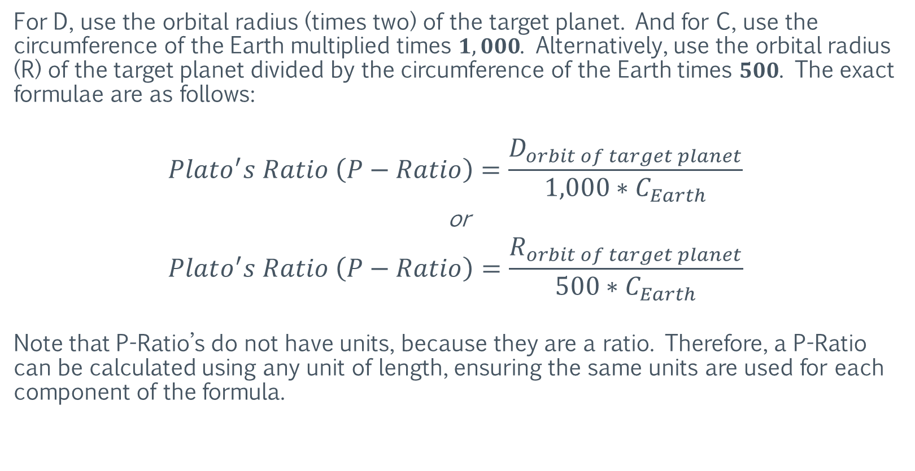
Atlantis & Plato’s Ratio
Atlantis represents a scale model of the solar system
For D, use the orbital radius (times two) of the target planet. And for C, use the circumference of the Earth multiplied times $1,000$. Alternatively, use the orbital radius (R) of the target planet divided by the circumference of the Earth times $500$. The exact formulae are as follows:
$$Plato^{′}s Ratio \left(P−Ratio\right)=\frac{D_{orbit of target planet}}{1,000∗C_{Earth}}$$
or
$$Plato^{′}s Ratio \left(P−Ratio\right)=\frac{R_{orbit of target planet}}{500∗C_{Earth}}$$
Note that P-Ratio’s do not have units, because they are a ratio. Therefore, a P-Ratio can be calculated using any unit of length, ensuring the same units are used for each component of the formula.

Slide 38

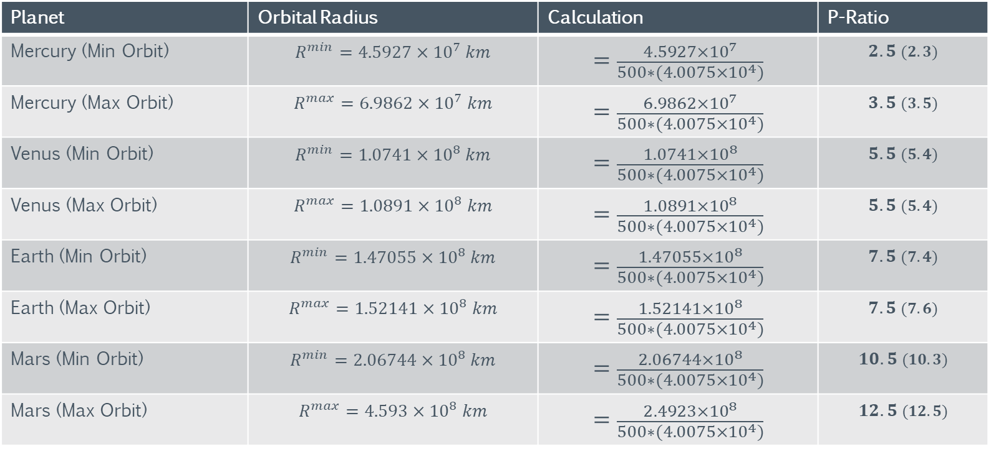
Atlantis & Plato’s Ratio
Using this formula, the P-Ratio for each of the inner planets can be calculated. Use the following value for the circumference of the Earth:
$$C_{Earth=4.0075×{10}^{4} km}$$
Planet | Orbital Radius | Calculation | P-Ratio
Mercury (Min Orbit) | $$R^{min}=4.5927×{10}^{7} km$$ | $$=\frac{4.5927×{10}^{7}}{500∗(4.0075×{10}^{4})}$$ | $$2.5 (2.3)$$
Mercury (Max Orbit) | $$R^{max}=6.9862×{10}^{7} km$$ | $$=\frac{6.9862×{10}^{7}}{500∗(4.0075×{10}^{4})}$$ | $$3.5 (3.5)$$
Venus (Min Orbit) | $$R^{min}=1.0741×{10}^{8} km$$ | $$=\frac{1.0741×{10}^{8}}{500∗(4.0075×{10}^{4})}$$ | $$5.5 (5.4)$$
Venus (Max Orbit) | $$R^{max}=1.0891×{10}^{8} km$$ | $$=\frac{1.0891×{10}^{8}}{500∗(4.0075×{10}^{4})}$$ | $$5.5 (5.4)$$
Earth (Min Orbit) | $$R^{min}=1.47055×{10}^{8} km$$ | $$=\frac{1.47055×{10}^{8}}{500∗(4.0075×{10}^{4})}$$ | $$7.5 (7.4)$$
Earth (Max Orbit) | $$R^{max}=1.52141×{10}^{8} km$$ | $$=\frac{1.52141×{10}^{8}}{500∗(4.0075×{10}^{4})}$$ | $$7.5 (7.6)$$
Mars (Min Orbit) | $$R^{min}=2.06744×{10}^{8} km$$ | $$=\frac{2.06744×{10}^{8}}{500∗(4.0075×{10}^{4})}$$ | $$10.5 (10.3)$$
Mars (Max Orbit) | $$R^{max}=4.593×{10}^{8} km$$ | $$=\frac{2.4923×{10}^{8}}{500∗(4.0075×{10}^{4})}$$ | $$12.5 (12.5)$$
P-Ratio fraction values are rounded to the nearest half (rounds the diameter).

Slide 39
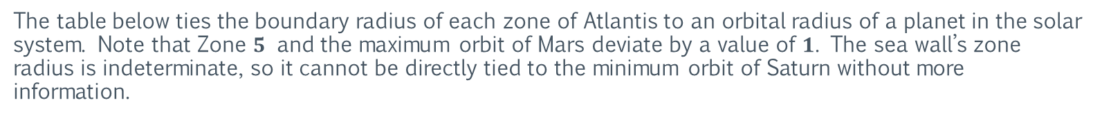
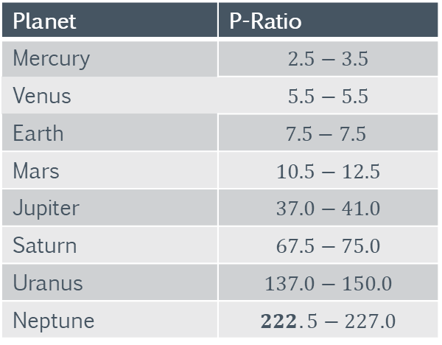
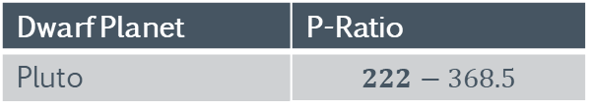
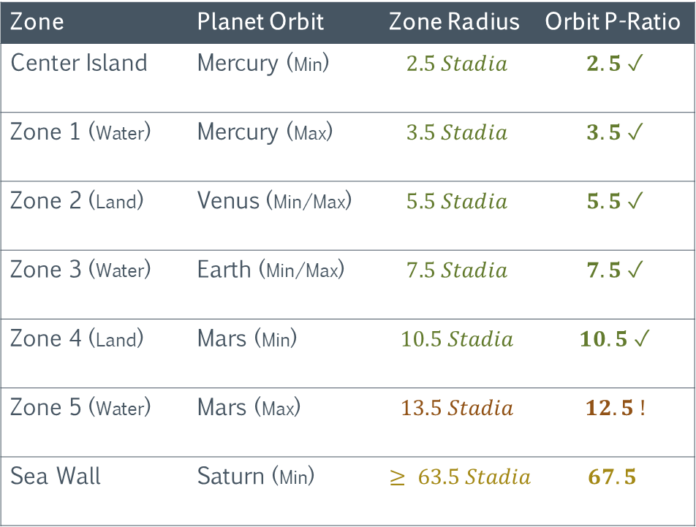
Atlantis & Plato’s Ratio
The table below ties the boundary radius of each zone of Atlantis to an orbital radius of a planet in the solar system. Note that Zone $5$ and the maximum orbit of Mars deviate by a value of $1$. The sea wall’s zone radius is indeterminate, so it cannot be directly tied to the minimum orbit of Saturn without more information.
Zone | Planet Orbit | Zone Radius | Orbit P-Ratio
Center Island | Mercury (Min) | $$2.5 Stadia$$ | $$2.5 ✓$$
Zone 1 (Water) | Mercury (Max) | $$3.5 Stadia$$ | $$3.5 ✓$$
Zone 2 (Land) | Venus (Min/Max) | $$5.5 Stadia$$ | $$5.5 ✓$$
Zone 3 (Water) | Earth (Min/Max) | $$7.5 Stadia$$ | $$7.5 ✓$$
Zone 4 (Land) | Mars (Min) | $$10.5 Stadia$$ | $$10.5 ✓$$
Zone 5 (Water) | Mars (Max) | $$13.5 Stadia$$ | $$12.5 !$$
Sea Wall | Saturn (Min) | $$≥ 63.5 Stadia$$ | $$67.5$$
Planet | P-Ratio
Mercury | $$2.5−3.5$$
Venus | $$5.5−5.5$$
Earth | $$7.5−7.5$$
Mars | $$10.5−12.5$$
Jupiter | $$37.0−41.0$$
Saturn | $$67.5−75.0$$
Uranus | $$137.0−150.0$$
Neptune | $$222.5−227.0$$
The table above lists the P-Ratio’s for all the planets in the solar system.
Dwarf Planet | P-Ratio
Pluto | $$222−368.5$$
P-Ratio (radius ratio) fraction values are rounded to the nearest half (rounds the diameter).

Slide 40
Section II: Deriving the Ant
The following section uses Plato’s description of Atlantis and natural physical constants to infer the unit of length used in Atlantis. The purpose is to establish the “true” measurements of Atlantis, which can subsequently be compared with the known measurements of archaeological sites.

Slide 41
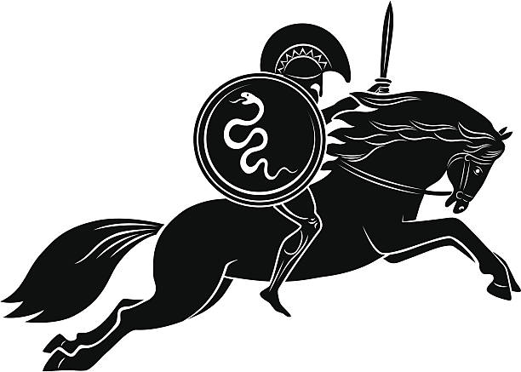
Deriving the Ant
The Stadion
As previously stated, it is unlikely that Atlantis would have been designed/built using a Greek unit of measure, such as the stadion. So, the unit of length used by the designers/builders of Atlantis was not the stadion, and its name and relative length are unknown. Or are at least not directly stated by Plato.
https://en.wikipedia.org/wiki/Stadion_(unit)

Slide 42
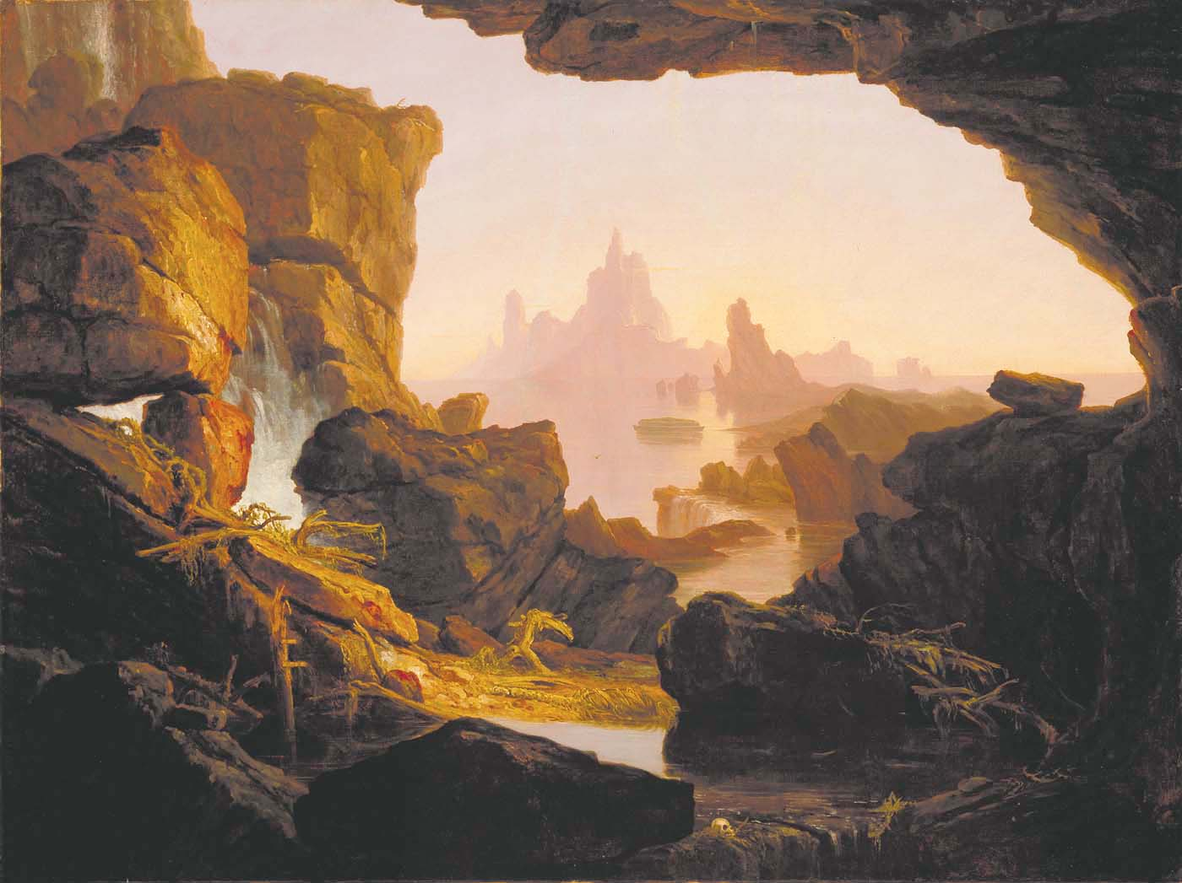
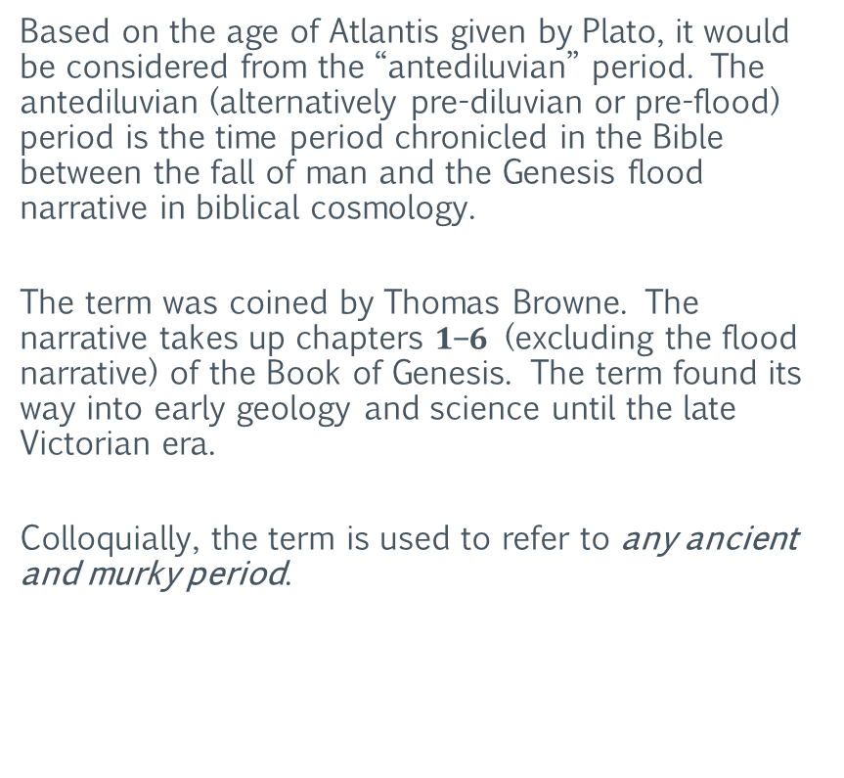
Deriving the Ant
Antediluvian
Based on the age of Atlantis given by Plato, it would be considered from the “antediluvian” period. The antediluvian (alternatively pre-diluvian or pre-flood) period is the time period chronicled in the Bible between the fall of man and the Genesis flood narrative in biblical cosmology.
The term was coined by Thomas Browne. The narrative takes up chapters $1$–$6$ (excluding the flood narrative) of the Book of Genesis. The term found its way into early geology and science until the late Victorian era.
Colloquially, the term is used to refer to any ancient and murky period.
https://en.wikipedia.org/wiki/Antediluvian

Slide 43
Deriving the Ant
The Ant
Going forward, the unit of length used in Atlantis will be referred to as the Antediluvian Common Unit of Length (Ant for short). Its capitalization rules will follow that of the meter. Meaning it is not a proper noun (except within its definition). Its abbreviation will be a lower case “a”. It will scale in the same manner as the meter, and with the same prefixes as well. For example, a kiloant (kilo-ant) is equal to 1,000 ants, the same way a kilometer is equal to 1,000 meters.
https://en.wikipedia.org/wiki/Antediluvian

Slide 44
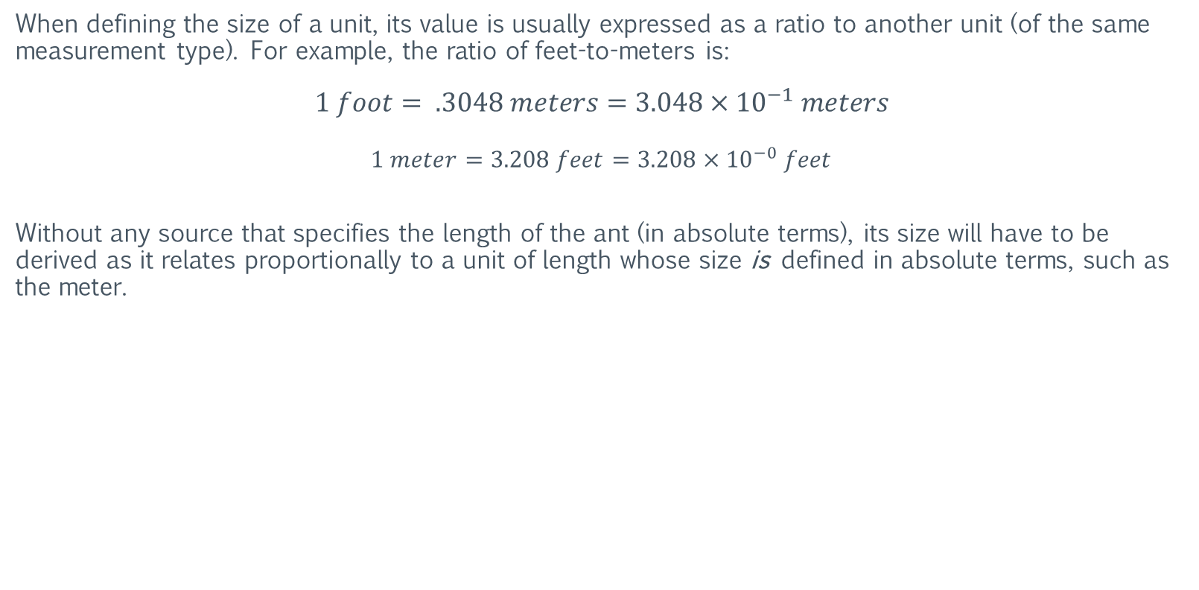
Deriving the Ant
Relative Length
When defining the size of a unit, its value is usually expressed as a ratio to another unit (of the same measurement type). For example, the ratio of feet-to-meters is:
$$1 foot= .3048 meters=3.048×{10}^{−1} meters$$
$$1 meter=3.208 feet=3.208×{10}^{−0} feet$$
Without any source that specifies the length of the ant (in absolute terms), its size will have to be derived as it relates proportionally to a unit of length whose size is defined in absolute terms, such as the meter.

Slide 45

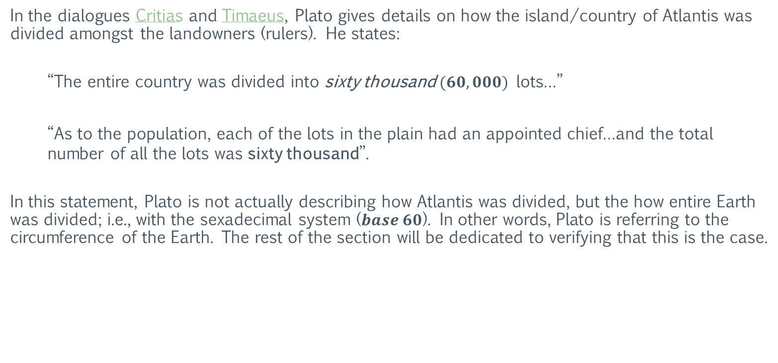
Deriving the Ant
Division
In the dialogues Critias and Timaeus, Plato gives details on how the island/country of Atlantis was divided amongst the landowners (rulers). He states:
“The entire country was divided into sixty thousand $(60,000)$lots…”
“As to the population, each of the lots in the plain had an appointed chief…and the total number of all the lots was sixty thousand”.
In this statement, Plato is not actually describing how Atlantis was divided, but the how entire Earth was divided; i.e., with the sexadecimal system ($base 60$). In other words, Plato is referring to the circumference of the Earth. The rest of the section will be dedicated to verifying that this is the case.

Slide 46
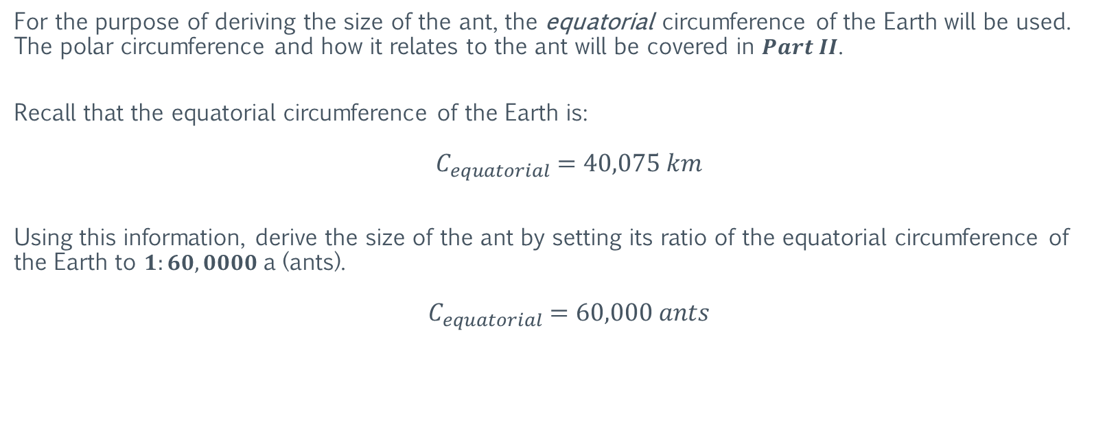
Deriving the Ant
Division
For the purpose of deriving the size of the ant, the equatorial circumference of the Earth will be used. The polar circumference and how it relates to the ant will be covered in $Part II$.
Recall that the equatorial circumference of the Earth is:
$${ C}_{equatorial} =40,075 km$$
Using this information, derive the size of the ant by setting its ratio of the equatorial circumference of the Earth to $1:60,0000$a (ants).
$${ C}_{equatorial} =60,000 ants$$

Slide 47
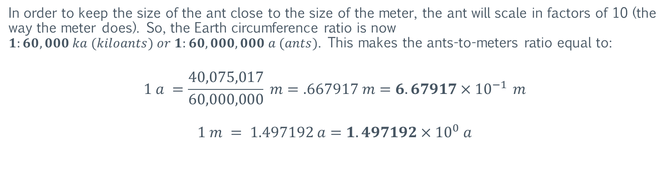
Deriving the Ant
Scaling
In order to keep the size of the ant close to the size of the meter, the ant will scale in factors of 10 (the way the meter does). So, the Earth circumference ratio is now $1:60,000 ka (kiloants) or 1:60,000,000 a (ants)$. This makes the ants-to-meters ratio equal to:
$$1 a =\frac{40,075,017}{60,000,000} m=.667917 m=6.67917×{10}^{−1 }m$$
$$1 m = 1.497192 a=1.497192×{10}^{0} a$$

Slide 48
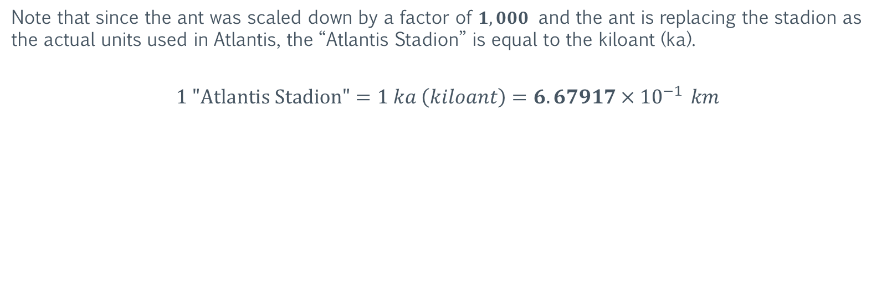
Deriving the Ant
Scaling
Note that since the ant was scaled down by a factor of $1,000$ and the ant is replacing the stadion as the actual units used in Atlantis, the “Atlantis Stadion” is equal to the kiloant (ka).
$$1 \text{"}\text{Atlantis} \text{Stadion}\text{"}=1 ka \left(kiloant\right)=6.67917×{10}^{−1 }km$$

Slide 49
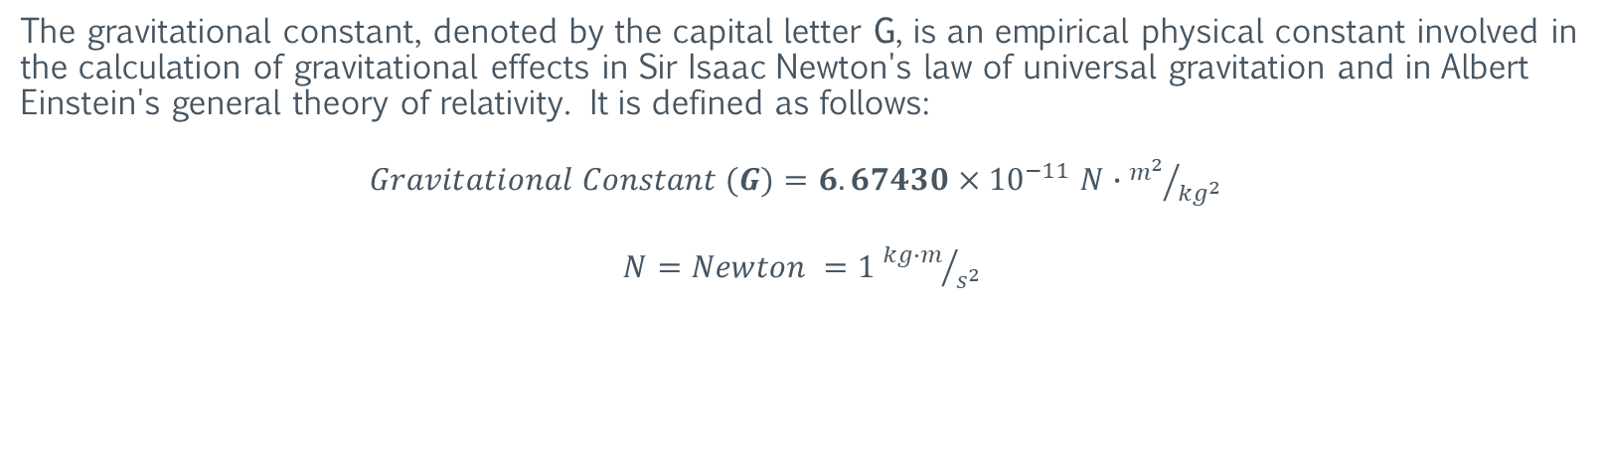
Deriving the Ant
The Gravitational Constant
The gravitational constant, denoted by the capital letter G, is an empirical physical constant involved in the calculation of gravitational effects in Sir Isaac Newton's law of universal gravitation and in Albert Einstein's general theory of relativity. It is defined as follows:
$Gravitational Constant (G)=6.67430×{10}^{−11}$ $N∙{m^{2}}/{{kg}^{2}}$
$N=Newton =1$ ${kg∙m}/{s^{2}}$
https://en.wikipedia.org/wiki/Gravitational_constant

Slide 50
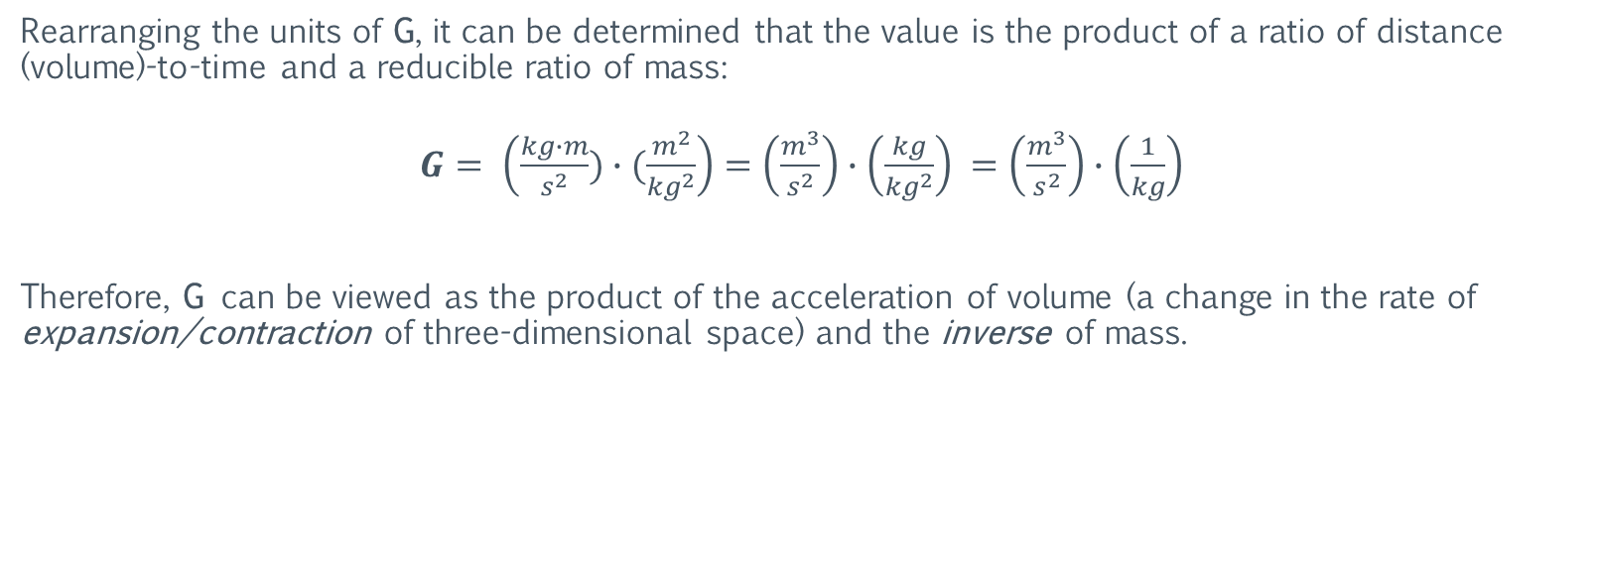
Deriving the Ant
The Gravitational Constant
Rearranging the units of G, it can be determined that the value is the product of a ratio of distance (volume)-to-time and a reducible ratio of mass:
$G= \left(\frac{kg∙m}{s^{2}})∙(\frac{m^{2}}{{kg}^{2}}\right)=\left(\frac{m^{3}}{s^{2}}\right)∙\left(\frac{kg}{{kg}^{2}}\right)$ $=\left(\frac{m^{3}}{s^{2}}\right)∙\left(\frac{1}{kg}\right)$
Therefore, G can be viewed as the product of the acceleration of volume (a change in the rate of expansion/contraction of three-dimensional space) and the inverse of mass.
https://en.wikipedia.org/wiki/Gravitational_constant

Slide 51
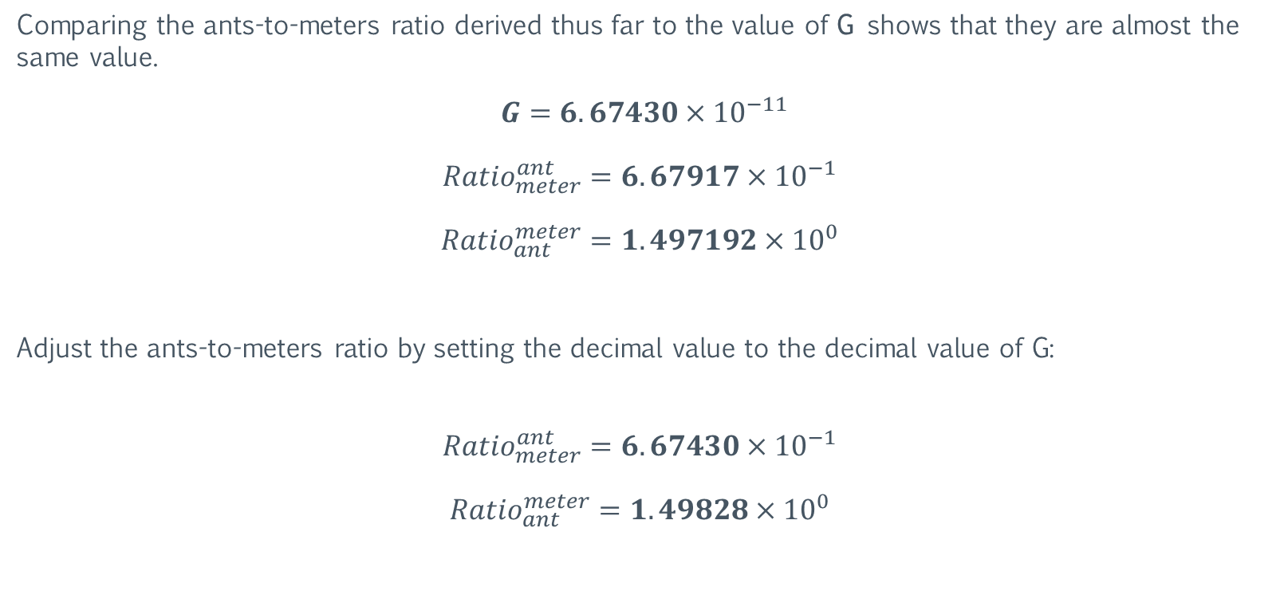
Deriving the Ant
The Gravitational Constant
Comparing the ants-to-meters ratio derived thus far to the value of G shows that they are almost the same value.
$$G=6.67430×{10}^{−11}$$
$${Ratio}_{meter}^{ant}=6.67917×{10}^{−1 }$$
$${Ratio}_{ant}^{meter}=1.497192×{10}^{0 }$$
Adjust the ants-to-meters ratio by setting the decimal value to the decimal value of G:
$${Ratio}_{meter}^{ant}=6.67430×{10}^{−1 }$$
$${Ratio}_{ant}^{meter}=1.49828×{10}^{0 }$$
https://en.wikipedia.org/wiki/Gravitational_constant

Slide 52
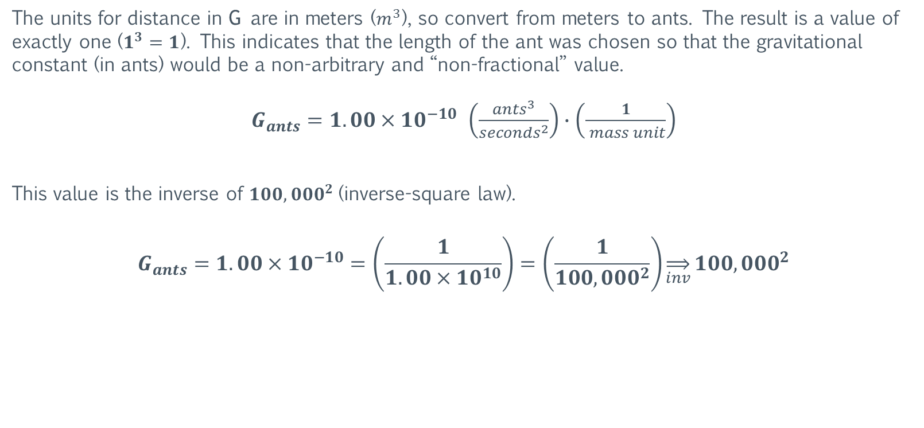
Deriving the Ant
The Gravitational Constant
The units for distance in G are in meters ($m^{3}$), so convert from meters to ants. The result is a value of exactly one ($1^{3}=1$). This indicates that the length of the ant was chosen so that the gravitational constant (in ants) would be a non-arbitrary and “non-fractional” value.
$G_{ants}=1.00×{10}^{−10}$ $\left(\frac{{ants}^{3}}{{seconds}^{2}}\right)∙\left(\frac{1}{ mass unit}\right)$
This value is the inverse of ${100,000}^{2}$(inverse-square law).
$$G_{ants}=1.00×{10}^{−10}=\left(\frac{1}{1.00×{10}^{10}}\right)=\left(\frac{1}{{100,000}^{2}}\right)\overset{⇒}{inv}{100,000}^{2}$$
https://en.wikipedia.org/wiki/Inverse-square_law

Slide 53

Deriving the Ant
The Gravitational Constant
It is noteworthy that the inverse of G is approximately equal to the average orbital radius of the Earth (in decameters); with a difference of 0.15%. This means that twice a year, the distance from the Earth to the Sun is exactly equal to the inverse of G.
$$\frac{G}{1}\overset{⇒}{inv}\frac{1}{G}=\frac{1}{6.67430 × {10}^{−11}}=1.4982 × {10}^{10}$$
$${Average Radius}_{Earth}^{Orbit}=1.4960 × {10}^{10}$$
https://en.wikipedia.org/wiki/Gravitational_constant

Slide 54

Deriving the Ant
Ant Mass
In 2019, the official size of the kilogram was tied directly to the meter and the second. Therefore, mass and distance participate in a proportional relationship with time. And because G is the product of a ratio of mass, a complimentary unit of mass for the ant needs to be derived. This unit will represent the unit of mass used in Atlantis.
$G_{ants}=1.00×{10}^{−10}$ $\left(\frac{{ants}^{3}}{{seconds}^{2}}\right)∙\left(\frac{1}{Atlantis mass unit}\right)$
https://en.wikipedia.org/wiki/Kilogram

Slide 55

Deriving the Ant
The Tenna (Ant Mass)
Going forward, the units of mass used in Atlantis will be called the Tenna (plural Tennae). The name is a derivative of the word antenna (as in ant-tenna). Its capitalization rules will follow that of the gram. Meaning it is not a proper noun (except within its definition). Its abbreviation will be a lower case “t”. It will scale in the same manner as the gram, and with the same prefixes as well. For example, a kilotenna (kilo-tenna) is equal to 1,000 tennae, the same way a kilogram is equal to 1,000 grams.

Slide 56

Deriving the Ant
The Tenna
The ratio of kilotennae-to-kilograms can be derived by calculating the gravitational acceleration (small g) of a known mass, such as the Earth.
$$g = \frac{(G_{m})∙{(Mass}_{Earth}^{kg})}{{{(Radius}_{Earth}^{m})}^{2}}$$
$g = \frac{\left(6.67430 × {10}^{−11}\right) × (5.97240 × {10}^{24})}{(4.068063 × {10}^{13})}$ $=9.798665 m/{s^{2}}$

Slide 57

Deriving the Ant
The Tenna
Convert $g$ to ants and then calculate the mass of the Earth in kilotennae.
$$9.798665 m/{s^{2}}=14.681205 a/{s^{2}}$$
$$14.681205= \frac{\left(1.00×{10}^{−10}\right)× {(Mass}_{Earth}^{kt})}{(9.13223925× {10}^{13}{ a}^{2}) }$$
${Mass}_{Earth}^{kt}=\frac{(14.681205)×(9.13223925 × {10}^{13})}{(1.00×{10}^{−10})}=$ $1.340723 × {10}^{25} kt$
$${Ratio}_{kilotenna}^{kilograms}=\frac{5.97240 × {10}^{24} kg}{1.340723 × {10}^{25} kt}$$

Slide 58

Deriving the Ant
The Tenna
The resulting ratio is:
$${Ratio}_{kilotenna}^{kilograms}=4.454617×{10}^{−1}$$
$${Ratio}_{kilograms}^{kilotenna}=2.244862×{10}^{0}$$
And the ratio of ants-to-meters is:
$${Ratio}_{meters}^{ants}=6.67430×{10}^{−1 }$$
$${Ratio}_{ants}^{meters}=1.49828×{10}^{0 }$$

Slide 59

Deriving the Ant
Antediluvian Circumference of the Earth
The current equatorial circumference of the Earth is:
$$\frac{4.0075×{10}^{4} km}{6.67430×{10}^{−1} }=6.0044×{10}^{4} ka=60,044 kiloants$$
This indicates that the circumference of the Earth has increased since length of the ant was defined (with a ratio of 1:60,000). This is because sea levels have increased since the end of the last ice age (around 10,000 BCE). The increase in water is from the melting of polar ice sheets.
https://en.wikipedia.org/wiki/Climate_change

Slide 60

Deriving the Ant
Antediluvian Circumference of the Earth
Using this information, the equatorial circumference of the Earth during the last ice age can be inferred:
$$6.00×{10}^{4} ka∗6.67430×{10}^{−1}=4.0045754×{10}^{4} km=40,045.8 kilometers$$
And from this, it should be possible to approximate the sea levels during or towards the end of the last ice age. This information can be useful when compiling climate data and building global climate models.
https://en.wikipedia.org/wiki/Climate_change

Slide 61

Deriving the Ant
Verify the Ant with the Sacred Cubit
To verify that the ratio of ants-to-meters is accurate, compare it to a known unit of measure (of ancient origin). The size of the “Sacred Cubit” is known, so this can be used to verify the size of the ant.
The sacred cubit and the pyramid inch are units of measure that were defined in ancient Egypt. The pyramid inch is equal to one twenty-fifth ($\frac{1}{25}$) of the sacred cubit.
The size of the pyramid inch is defined as $1.00106$ imperial inches, or $2.5426924$ centimeters. Given this, the sacred cubit-to-meter ratio is as follows:
$$Sacred Cubit=6.35647×{10}^{−1} meters$$
https://en.wikipedia.org/wiki/Pyramid_inch

Slide 62

Deriving the Ant
Verify the Ant with the Sacred Cubit
With this ratio, the current size of the Earth (in sacred cubits) is:
$${Circumference}_{Earth}^{equatorial}=6.3046036×{10}^{7} sacred cubits=63,046,036$$
$${Circumference}_{Earth}^{polar}=6.2831852×{10}^{7} sacred cubits=62,831,852$$
$${Radius}_{Earth}^{equatorial}=1.0034088 ×{10}^{7} sacred cubits=10,034,088$$
$${Radius}_{Earth}^{polar}=1.00000 ×{10}^{7} sacred cubits=10,000,000$$
Note that the polar radius of the Earth is exactly $10,000,000$ sacred cubits.
https://en.wikipedia.org/wiki/Pyramid_inch

Slide 63

Deriving the Ant
Verify the Ant with the Sacred Cubit
Recall that the antediluvian equatorial circumference (AEC) of the Earth is:
$AEC=4.00458×{10}^{7} meters$ = 40,045,754 m
Using this value for the AEC, the antediluvian size of the Earth (in sacred cubits) is:
$${Circumference}_{Earth}^{equatorial}=6.300000×{10}^{7} sacred cubits=63,000,000$$
$${Circumference}_{Earth}^{polar}=6.2831852×{10}^{7} sacred cubits=62,831,852$$
$${Radius}_{Earth}^{equatorial}=1.0026761 ×{10}^{7} sacred cubits=10,026, 761$$
$${Radius}_{Earth}^{polar}=1.00000 ×{10}^{7} sacred cubits=10,000,000$$
Note that the equatorial circumference of the Earth is exactly $63,000,000$ sacred cubits. This is a mathematical indicator that the derived ants-to-meters ratio is accurate. This is also a mathematical indicator that the sacred cubit unit was derived during the antediluvian time period.
https://en.wikipedia.org/wiki/Pyramid_inch

Slide 64

Deriving the Ant
Verify the Ant with the Olympic Stadion
The ant-to-meter ratio can also be verified using the Olympic stadion. Recall the stadion is defined as follows:
$$1 Olympic stadion (OS) =1.76576×{10}^{2} m=176.576 m$$
With this ratio, the current size of the Earth (in Olympic stadion) is:
$${Circumference}_{Earth}^{equatorial}=2.26965730×{10}^{5} Olympic Stadia=226,966$$
$${Circumference}_{Earth}^{polar}=2.26194668×{10}^{5} Olympic Stadia=226,195$$
$${Radius}_{Earth}^{equatorial}=3.6122718 ×{10}^{4} Olympic Stadia=36,123$$
$${Radius}_{Earth}^{polar}=3.60000 ×{10}^{4} Olympic Stadia=36,000$$
Note that the polar radius of the Earth is exactly $36,000$ Olympic stadia.
https://en.wikipedia.org/wiki/Stadion_(unit)

Slide 65

Deriving the Ant
Verify the Ant with the Olympic Stadion
Recall that the antediluvian equatorial circumference (AEC) of the Earth is:
$AEC=4.00458×{10}^{7} meters$ = 40,045,754 m
Using this value for the AEC, the antediluvian size of the Earth (in Olympic stadion) is:
$${Circumference}_{Earth}^{equatorial}=2.2680000×{10}^{5} Olympic Stadia=226,800$$
$${Circumference}_{Earth}^{polar}=2.26194668×{10}^{5} Olympic Stadia=226,195$$
$${Radius}_{Earth}^{equatorial}=3.6096341 ×{10}^{4} Olympic Stadia=36,096$$
$${Radius}_{Earth}^{polar}=3.60000 ×{10}^{4} Olympic Stadia=36,000$$
Note that the equatorial circumference of the Earth is exactly $226,800$ Olympic stadia. This is another mathematical indicator that the derived ants-to-meters ratio is accurate. This is also another mathematical indicator of an ancient unit of measure (the Olympic stadion) being derived during the antediluvian time period.
https://en.wikipedia.org/wiki/Stadion_(unit)

Slide 66

Deriving the Ant
Verify the Ant with the Olympic Stadion
Note the relationship of the Antediluvian Equatorial Circumference (AEC) of the Earth in Olympic Stadion ($226,800)$ and sacred cubits ($63,000,000):$
$$63° (degrees)=226,800" (arcseconds)$$
https://en.wikipedia.org/wiki/Stadion_(unit)

Slide 67

Deriving the Ant
Plato’s Number
The value of $226,800$ is of additional significance because it appears to be Plato’s Number:
Plato's number is a number enigmatically referred to by Plato in his dialogue the Republic. The text is notoriously difficult to understand, and its corresponding translations do not allow an unambiguous interpretation. There is no real agreement either about the meaning or the value of the number. It also has been called the "geometrical number" or the "nuptial number" (the "number of the bride").
Great lexical and syntactical differences are easily noted between the many translations of the Republic. Below is a typical text from a relatively recent translation of Republic 546b–c:
“Now for divine begettings there is a period comprehended by a perfect number, and for mortal by the first in which augmentations dominating and dominated when they have attained to three distances and four limits of the assimilating and the dissimilating, the waxing and the waning, render all things conversable and commensurable with one another, whereof a basal four-thirds wedded to the pempad yields two harmonies at the third augmentation, the one the product of equal factors taken one hundred times, the other of equal length one way but oblong,-one dimension of a hundred numbers determined by the rational diameters of the pempad lacking one in each case, or of the irrational lacking two; the other dimension of a hundred cubes of the triad. And this entire geometrical number is determinative of this thing, of better and inferior births”.
https://en.wikipedia.org/wiki/Plato%27s_number

Slide 68

Deriving the Ant
Plato’s Number
The passage in which Plato introduced the number has been discussed ever since it was written, with no consensus in the debate. Since the text is so ambiguous, its interpretation can produce more than one value. In addition, the same value can be produced from different interpretations.
However, the value derived for the Antediluvian Equatorial Circumference (AEC) of the Earth in Olympic Stadion appears to be Plato’s number.
$$AEC=226,800 Olympic Stadia$$
$$Plato^{′}s Number=226,800,000= 9! × 5^{4}$$
The number is significant because when the P-Ratio for the Earth is set to 7.56, the orbital radius of the Earth is exactly 226,800,000 kiloants. This P-Ratio is slightly below the current maximum orbital radius of Earth, which is 7.6, and represents the antediluvian maximum orbital radius of the Earth. This will be discussed in $Part III$.
This is an indicator of why Plato chose to give the measurements of Atlantis in units of stadia, but the values in ants.
https://en.wikipedia.org/wiki/Plato%27s_number

Slide 69

Deriving the Ant
Plato’s War-Chariot
In his dialogue, Timaeus, Plato states that the leader of each of the $60,000$ “lots” of Atlantis are bound to provide the $sixth$ part of a war-chariot. His description of the war-chariot is as follows:
“…two horses and riders upon them, a pair of chariot-horses without a seat, and an attendant and charioteer, two hoplites, two archers, two slingers, three stone-shooters, three javelin-men, and four sailors…”
https://en.wikipedia.org/wiki/Critias

Slide 70





Deriving the Ant
War-Chariot Component | Derived Number
Two ($2$) horses | $$2$$
and ($2$) riders upon them, | $$2$$
a pair of ($2$) chariot-horses | $$2$$
without ($0$) a seat, | $$0$$
and ($1$) an attendant | $$1$$
and ($1$) charioteer; | $$1$$
two ($2$) hoplites, | $$2$$
two ($2$) archers, | $$2$$
two ($2$) slingers, | $$2$$
three ($3$) stone-shooters, | $$3$$
three ($3$) javelin-men, | $$3$$
and four ($4$) sailors. | $$4$$
Plato’s War-Chariot
Plato is revealing a number with the components of the war-chariot. The table below shows this number and the table to the right illustrates how it is derived.
Derived Number | $$222,011,222,334$$
$$\text{Earth} \text{Min}\text{. }\text{Orbit}\text{ (}\text{ants}\text{)}$$ | $$\sim 220,000,000,000$$
$$\text{Earth} \text{Avg}\text{. }\text{Orbit}\text{ (}\text{ants}\text{)}$$ | $$\sim 224,000,000,000$$
$$\text{Earth} \text{Max}\text{. }\text{Orbit}\text{ (}\text{ants}\text{)}$$ | $$\sim 228,000,000,000$$
This number represents the average orbital radius of the Earth in ants ($\sim 1.49598×{10}^{11 }meters$)*.
This is confirmation that the division of Atlantis (of $60,000$ lots) is indeed referring to the circumference of the Earth.
*The derived number would create an orbital period of $exactly 360 days$. This will be discussed in $Part III$.
https://en.wikipedia.org/wiki/Checkmate

Slide 71

Deriving the Ant
The Precision of the Sacred Cubit
Having the value for the antediluvian circumference of the Earth in sacred cubits ($63,000,000$) and the ratio of sacred cubits to meters allows for an even more precise calculation of the ants-to-meters ratio. The calculations below show how the more precise ratio is derived.
$$1 pyramid inch = 2.5426924 centimeters$$
$$1 sacred cubit = 25 pyramid inches$$
$$1 sacred cubit = 63.56731 centimeters = .6356731 meters$$
$$63,000,000 sacred cubits =40,047,405.3 meters$$
$AEC=4.00474053×{10}^{7} meters$ = $40,047,405.3 meters$
$$60,000,000 ants =40,047,405.3 meters$$
https://en.wikipedia.org/wiki/Pyramid_inch

Slide 72


Deriving the Ant
The Precision of the Sacred Cubit
The resulting ratio is:
$$1 ant=6.67456755×{10}^{−1 }meters$$
$$1 meter=1.4982244×{10}^{0 }ants$$
This ratio can be used to derive a more precise value of the gravitational constant (G).
$$G=6.67456755×{10}^{−11}$$
Note that the above value for $G$ is a calculated value, as opposed to a measured (observed) value.

Slide 73

Deriving the Ant
The Precision of the Tenna
Since a parameter value used to calculate the ratio of the tenna has changed, it will need to be re-calculated.
$$g = \frac{(G_{m})∙{(Mass}_{Earth}^{kg})}{{{(Radius}_{Earth}^{m})}^{2}}$$
$g = \frac{\left(6.67456755× {10}^{−11}\right) × (5.97240 × {10}^{24})}{(4.068063 × {10}^{13})}$ $=9.7990585m/{s^{2}}$
$$9.7990585 m/{s^{2}}=14.6811886 a/{s^{2}}$$

Slide 74

Deriving the Ant
The Precision of the Tenna
Since a parameter value used to calculate the ratio of the tenna has changed, it will need to be re-calculated.
$$9.7990585 m/{s^{2}}=14.6811886 a/{s^{2}}$$
$$14.6811886= \frac{\left(1.00×{10}^{−10}\right)× {(Mass}_{Earth}^{kt})}{(9.1314848855 × {10}^{13}{ a}^{2}) }$$
${Mass}_{Earth}^{kt}=\frac{(14.6811886)×(9.1314848855× {10}^{13})}{(1.00×{10}^{−10})}=$ $1.3406105 × {10}^{25} kt$
$${Ratio}_{kilotenna}^{kilograms}=\frac{5.97240 × {10}^{24} kg}{1.3406105× {10}^{25} kt}$$

Slide 75

Deriving the Ant
The Precision of the Tenna
Since a parameter value used to calculate the ratio of the tenna has changed, it will need to be re-calculated.
$${Ratio}_{kilotenna}^{kilograms}=\frac{5.97240 × {10}^{24} kg}{1.3406105× {10}^{25} kt}$$
$${Ratio}_{kilotenna}^{kilograms}=\text{4.45498519795130025}×{10}^{−1}$$
$${Ratio}_{kilograms}^{kilotenna}=\text{2.2446763694}\text{29612} ×{10}^{0}$$

Slide 76

Deriving the Ant
The Shortcut to the Tenna
An alternative (and faster) method of calculating the ratio of the tenna to the kilogram can be accomplished by squaring the ratio of the ant to the meter.
$${Ratio}_{meters}^{ants}=6.67456755×{10}^{−1}$$
$${Ratio}_{kilograms}^{kilotenna}={(0.667456755)}^{2}=4.4549851×{10}^{−1}$$

Slide 77


Deriving the Ant
The Ant is Derived and Verified
The precision of the unit comparisons indicate that the derived ants-to-meters is accurate. The ratio is as follows:
$$1 ant=6.67456755×{10}^{−1 }meters$$
$$1 meter=1.49822440×{10}^{0 }ants$$
The precision of the unit comparisons also indicate that both the sacred cubit and the Olympic stadion are of antediluvian origin. Their ratios are as follows:
$$1 sacred cubit=6.356731×{10}^{−1} meters$$
$$1 meter=1.57313562×{10}^{0 }sacred cubits$$
$$1 Olympic stadion =1.76575861×{10}^{−1} meters$$
$$1 meter=5.6632882530×{10}^{0 }Olympic stadia$$

Slide 78

Deriving the Ant
The Ant Defined
The unit of length used in Atlantis is referred to as the Antediluvian Common Unit of Length (Ant for short).
Its capitalization rules follow that of the meter; meaning it is not a proper noun (except within its definition). Its abbreviation is a lower case “a”.
The ant scales in the same manner as the meter, and with the same prefixes as well.
The size of the ant (as a ratio to the meter) is defined as follows:
$$1 ant=6.67456755×{10}^{−1 }meters$$
$$1 meter=1.49822440×{10}^{0 }ants$$
Prefix | Symbol | Factor | Power
tera | T | 1000000000000 | 10¹²
giga | G | 1000000000 | 10⁹
mega | M | 1000000 | 10⁶
kilo | k | 1000 | 10³
hecto | h | 100 | 10²
deca | da | 10 | 10¹
(none) | (none) | 1 | 10⁰
deci | d | 0.1 | 10⁻¹
centi | c | 0.01 | 10⁻²
milli | m | 0.001 | 10⁻³
micro | μ | 0.000001 | 10⁻⁶
nano | n | 0.000000001 | 10⁻⁹
pico | p | 0.000000000001 | 10⁻¹²
The table above lists the prefixes and factor values used when scaling the ant.

Slide 79

Deriving the Ant
The Tenna Defined
The unit of mass used in Atlantis is referred to as the Tenna (plural Tennae). The name is a derivative of the word antenna (as in ant-tenna).
Its capitalization rules follow that of the gram; meaning it is not a proper noun (except within its definition). Its abbreviation is a lower case “t”.
The tenna scales in the same manner as the gram, and with the same prefixes as well.
The size of the tenna (as a ratio to the gram) is defined as follows:
$$1 tenna=4.4549851979513×{10}^{−1 }grams$$
$$1 gram=2.2446763694296×{10}^{0 }tennae$$
Prefix | Symbol | Factor | Power
tera | T | 1000000000000 | 10¹²
giga | G | 1000000000 | 10⁹
mega | M | 1000000 | 10⁶
kilo | k | 1000 | 10³
hecto | h | 100 | 10²
deca | da | 10 | 10¹
(none) | (none) | 1 | 10⁰
deci | d | 0.1 | 10⁻¹
centi | c | 0.01 | 10⁻²
milli | m | 0.001 | 10⁻³
micro | μ | 0.000001 | 10⁻⁶
nano | n | 0.000000001 | 10⁻⁹
pico | p | 0.000000000001 | 10⁻¹²
The table above lists the prefixes and factor values used when scaling the tenna.

Slide 80


Deriving the Ant: Notes
The Measure of a Human: The Cubit
As the name implies, the sacred cubit is related to the “common” cubit used primarily by the Sumerians, Egyptians and Israelites.
The cubit is based on the distance from the elbow to the middle finger (of a human). This measurement was usually taken directly from a Pharoah or a King.
The ratio of this distance (from the elbow to the middle finger) on a person to their height is $3.7$.
So, if the length from the elbow to the middle finger on a person (or a group of people) is known, the height of that person (or persons) can be inferred/calculated by multiplying the subject cubit size by $3.7$.
https://en.wikipedia.org/wiki/Cubit

Slide 81



Deriving the Ant: Notes
On the Shoulders of Giants
The ratio of the distance “from the elbow to the middle finger” and the “height” of a human is $3.7−3.78$.
So, if the length from the elbow to the middle finger on a person (or a group of people) is known, the height of that person (or persons) can be calculated by multiplying the subject cubit size by $3.7$.
Recall that the size of the sacred cubit is exactly $25$ pyramid inches. And the pyramid inch is equal to $1.00106$ imperial inches.
Therefore, a human with measurements close to that of the sacred cubit would be approximately $7.5−8 ft \left(2.286−2.31 m\right)$in height.
$$1 Sacred Cubit=\sim 25“$$
$$25“×3.7=\sim 92.5"=\sim 7′ 8"=\sim 2.35 m$$
https://en.wikipedia.org/wiki/Cubit

Slide 82
Section III: The Scale of Atlantis
The following section examines the size and scale of Atlantis by visually comparing its layout overlay with existing cities. The purpose is to demonstrate the relative size of Atlantis.

Slide 83

The Scale of Atlantis
The table below lists the derived dimensions of Atlantis. The last zone has a diameter of $18 km (11.18 miles),$while the sea wall has an estimated diameter of $84.7 km (52.4 miles).$
Zone/Area | Radius/Diameter Kiloants (ka) | Radius/Diameter Kilometers (km) | Radius/Diameter Miles
Center Island | $$2.5/5.0 ka$$ | $$1.66/3.33 km$$ | $$1.03/2.06 miles$$
Zone 1 (Water) | $$3.5/7.0 ka$$ | $$2.33/4.66 km$$ | $$1.48/2.96 miles$$
Zone 2 (Land) | $$5.5/11.0 ka$$ | $$3.66/7.33 km$$ | $$2.27/4.55 miles$$
Zone 3 (Water) | $$7.5/15.0 ka$$ | $$5.0/10.0 km$$ | $$3.12/6.24 miles$$
Zone 4 (Land) | $$10.5/21.0 ka$$ | $$7.0/14.0 km$$ | $$4.35/8.70 miles$$
Zone 5 (Water) | $$13.5/27.0 ka$$ | $$9.0/18.0 km$$ | $$5.59/11.18 miles$$
Sea Wall | $$≥63.5/127.0 ka$$ | $$≥42.3/84.7 km$$ | $$≥26.2/52.4 miles$$

Slide 84
The Scale of Atlantis
Atlantis Layout Overlay
18 kilometers/11.18 miles

Slide 85
The Scale of Atlantis
Washington D.C., USA
Washington D.C., USA
18 kilometers/11.18 miles

Slide 86
The Scale of Atlantis
Athens, Greece
Athens, Greece
18 kilometers/11.18 miles

Slide 87
The Scale of Atlantis
New York, USA
New York, USA
18 kilometers/11.18 miles

Slide 88
Section IV: Corpus Delicti
The following section examines the ruins of Atlantis located at the Richat Structure (Mauritania, Northwest Africa). The purpose is to determine if the structure is the physical location of Atlantis (ruins of Atlantis).

Slide 89


The Richat Structure
The Richat Structure (also called Guelb er Richât, the Eye of the Sahara, or the Eye of Africa) is a prominent circular geological feature in the Sahara's Adrar Plateau, near Ouadane, west–central Mauritania, Northwest Africa.
In the local dialect, Richat means feather and it also is known locally in Arabic as tagense. Tagense refers to the circular opening of the leather pouch used to draw water from local wells.
The structure is located at:
$$21.125644° N, −11.398714° W$$
https://en.wikipedia.org/wiki/Richat_Structure

Slide 90



The Richat Structure
https://en.wikipedia.org/wiki/Richat_Structure

Slide 91


The Richat Structure
https://en.wikipedia.org/wiki/Richat_Structure

Slide 92

The Richat Structure: Geology
The Richat Structure, also called Guelb er Richât, is a prominent circular geological feature in the Sahara's Adrar Plateau, near Ouadane, west–central Mauritania, Northwest Africa. In the local dialect, Richat means feather and it also is known locally in Arabic as tagense. Tagense refers to the circular opening of the leather pouch used to draw water from local wells.
According to geologists, it is an eroded geological dome, 40 km (25 mi) in diameter, exposing sedimentary rock in layers which appear as concentric rings. Igneous rock is exposed inside and there are rhyolites and gabbros which have undergone hydrothermal alteration, and a central megabreccia. The structure is also the location of exceptional accumulations of Acheulean archaeological artifacts.
Artifacts found at the site are typically redeposited, deflated, or both, in Late Pleistocene to early Holocene gravelly mud, muddy gravel, clayey sand, and silty sand. These sediments are often cemented into either concretionary masses or beds by calcrete.
Numerous concordant radiocarbon dates indicate that the bulk of sediments found accumulated between 15,000 and 8,000 BCE during the African humid period. These deposits lie directly upon deeply eroded and weathered bedrock.
https://en.wikipedia.org/wiki/Richat_Structure

Slide 93


The Richat Structure
Zones
Satellite images illustrating alignment of zones with physical features of the structure.
https://en.wikipedia.org/wiki/Richat_Structure

Slide 94


The Richat Structure
Zones
Satellite images illustrating alignment of zones with physical features of the structure.
https://en.wikipedia.org/wiki/Richat_Structure

Slide 95


The Richat Structure
Zones
Satellite images illustrating alignment of zones with physical features of the structure.
https://en.wikipedia.org/wiki/Richat_Structure

Slide 96


The Richat Structure
Sea Wall
Satellite images illustrating alignment of sea wall boundary with circular physical structure.
https://en.wikipedia.org/wiki/Richat_Structure

Slide 97

The Richat Structure: Elevation Profile
The following pages display a cross-sectional elevation profile of the area illustrated to the right.
The purpose of the elevation profile is to demonstrate that the Richat Structure’s dimensions match the dimensions derived for Atlantis in the previous sections.
The profile begins at the calculated center of the structure and extends outwards approximately 10.5 km. Therefore, it is a profile of the radius of Atlantis’s circular layout.
Each zone or area of Atlantis is highlighted along with its dimensions.

Slide 98



The Richat Structure: Elevation Profile
All Zones and Harbors
Type | All
Breadth | ~15.5 ka (10.33 km)
Radius | ~15.5 ka (10.33 km)
Center Island
Type | Land
Breadth | 5 ka (3.33 km)
Radius | 2.5 ka (1.66 km)
Zone 1
Type | Water
Breadth | 1 ka (.667 km)
Radius | 3.5 ka (2.33 km)

Slide 99



The Richat Structure: Elevation Profile
Zone 2
Type | Land
Breadth | 2 ka (1.33 km)
Radius | 5.5 ka (3.66 km)
Zone 3
Type | Water
Breadth | 2 ka (1.33 km)
Radius | 7.5 ka (5 km)
Zone 4
Type | Land
Breadth | 3 ka (2 km)
Radius | 10.5 ka (7 km)

Slide 100




The Richat Structure: Elevation Profile
Zone 5a
Type | Water
Breadth | 2 ka (1.33 km)
Radius | 12.5 ka (8.33 km)
Zone 5b
Type | Water
Breadth | 3 ka (2 km)
Radius | 13.5 ka (9 km)
Harbor
Type | Water
Breadth | > 2 ka (1.33 km)
Radius | > 15.5 ka (10.33 km)

Slide 101


The Richat Structure: Elevation Profile
Zone 5a
Type | Water
Breadth | 2 ka (1.33 km)
Radius | 12.5 ka (8.33 km)
Zone 5b
Type | Water
Breadth | 3 ka (2 km)
Radius | 13.5 ka (9 km)
Planet Orbit | Zone Radius | Orbit P-Ratio
Mars (Min) | $$10.5 ka$$ | $$10.5 ✓$$
Mars (Max) | $$13.5 ka$$ | $$12.5 !$$
Recall that the P-Ratio for the maximum orbital radius of Mars varied from the value given by Plato by 1 ka.
The area covered by this elevation profile aligns more closely with the calculated P-Ratio radius of 12.5, rather than the value of 13.5 given by Plato.

Slide 102



The Richat Structure: Elevation Profile
Zone 5a
Type | Water
Breadth | 2 ka (1.33 km)
Radius | 12.5 ka (8.33 km)
Zone 5b
Type | Water
Breadth | 3 ka (2 km)
Radius | 13.5 ka (9 km)
An alternate elevation profile taken at a different angle aligns more closely with the radius of 13.5 given by Plato. Other profiles (at varying angles) show inconsistent distances to the boundary of the last zone, which is identified by a spike in elevation.
Continental land deformation (via plate tectonics) can account for some of the inconsistencies. Also, Plato stated that the last zone was cut open in order to create a harbor. So, the altering of the last zone could account for some of the varying distances as well.

Slide 103
Section V: The Solar System (current)
Atlantis represents a scale model of the solar system. The following section examines the orbital layout of the planets and their alignments with the zones and structures of Atlantis. The purpose is to demonstrate how the orbits of the planets (of the solar system) are represented in the design/geography of Atlantis.

Slide 104
The Solar System
Orbital Alignments
Satellite images illustrating orbital alignment of the solar system with the zones and structures of Atlantis. The breadth of the highlighted orbit represents the minimum and maximum boundary of the orbit.
All Planets
Inner Planets thru Saturn

Slide 105
The Solar System
Orbital Alignments
Satellite images illustrating orbital alignment of the solar system with the zones and structures of Atlantis. The breadth of the highlighted orbit represents the minimum and maximum boundary of the orbit.
Inner Planet Orbits
Mercury, Venus, and Earth Orbits (Sun in center)

Slide 106
The Solar System
Orbital Alignments
Satellite images illustrating orbital alignment of the solar system with the zones and structures of Atlantis. The breadth of the highlighted orbit represents the minimum and maximum boundary of the orbit.
Inner Planet Orbits
Inner Planet Orbits

Slide 107
The Solar System
Orbital Alignments
Satellite images illustrating orbital alignment of the solar system with the zones and structures of Atlantis. The breadth of the highlighted orbit represents the minimum and maximum boundary of the orbit.
Inner Planet Orbits and Asteroid Belt
Inner Planet Orbits and Asteroid Belt

Slide 108
The Solar System
Orbital Alignments
Satellite images illustrating orbital alignment of the solar system with the zones and structures of Atlantis. The breadth of the highlighted orbit represents the minimum and maximum boundary of the orbit.
Inner Planet Orbits and Asteroid Belt
All Planet Orbits

Slide 109
The Solar System
The Sun: Atlantis
Satellite images illustrating the alignment of the Sun in the center of Atlantis. Since the Sun does not have an orbit, its radius is used in the P-Ratio calculation. Therefore, the “orbit” of the Sun represents its size. Note the small structures in the center of Atlantis and how they closely reflect the size of the Sun.
The Center of Atlantis
The Center of Atlantis with the overlay of the Sun

Slide 110
The Solar System
The Sun: Athens
Satellite images illustrating the alignment of the Sun in the center of Athens. Since the Sun does not have an orbit, its radius is used in the P-Ratio calculation. Therefore, the “orbit” of the Sun represents its size. Note how the overlay of the Sun aligns precisely with the fountain at the center of Athens.
The Center of Athens
The Center of Athens with the overlay of the Sun

Slide 111
The Solar System
Mercury
Satellite images illustrating the alignment of Mercury’s orbit. The breadth of the green highlighted orbit represents the minimum and maximum boundary of the orbit. The center of the island (highlighted in yellow) is the location of the Temple of Poseidon (as stated by Plato).
Orbital Zone of Mercury Enclosing the Center Island
Orbital Zone of Mercury Enclosing the Center Island

Slide 112
The Solar System
Mercury
Satellite images illustrating a geoglyph located just beyond the orbital zone of Mercury.
Geoglyph Outside the Orbital Zone of Mercury
Geoglyph Outside the Orbital Zone of Mercury

Slide 113
The Solar System
Venus
Satellite images illustrating the alignment of Venus’s orbit. The breadth of the teal highlighted orbit represents the minimum and maximum boundary of the orbit.
Orbital Zone of Venus
Orbital Zone of Venus

Slide 114
The Solar System
Venus – Arrayed with the Sun with the Moon Under Her Feet
Satellite images illustrating the alignment of Venus’s orbit. The breadth of the teal highlighted orbit represents the minimum and maximum boundary of the orbit. Note the egg-shaped anomaly located under the orbital zone of Venus and its resemblance to the face of the moon (its mirror image).
Orbital Zone of Venus
Orbital Zone of Venus

Slide 115

The Solar System
Venus - The Mirror of the Moon
Note that the values for the max orbital radius and object circumference of Venus and the Moon are “mirrors” of each other.
Object | Max Orbital Radius | Object Circumference
Venus | $$1.63∙{10}^{11} ants$$ | $$5.7∙{10}^{7} ants$$
Moon | $$5.7∙{10}^{8} ants$$ | $$1.63∙{10}^{7} ants$$

Slide 116
The Solar System
Earth
Satellite images illustrating the alignment of Earth’s orbit. The breadth of the blue highlighted orbit represents the minimum and maximum boundary of the orbit.
Orbital Zone of Earth
Orbital Zone of Earth

Slide 117
The Solar System
Earth
Satellite images illustrating the alignment of Earth’s orbit. The breadth of the blue highlighted orbit represents the minimum and maximum boundary of the orbit.
Orbital Zone of Earth
Orbital Zone of Earth

Slide 118

The Solar System
Earth – The Speed of Light
Note that the ratio of the speed of light to the equatorial circumference of the Earth is $∼7.5 \left(7.48\right),$ which is the P-Ratio for the average orbital radius of Earth. This ratio can be calculated using any measurement system.
Measurement System | Calculation | Result
Ants | $$\frac{4.4916∙{10}^{8} a/s}{6.0∙{10}^{7} a}$$ | $$7.48$$
Meters | $$\frac{2.9979∙{10}^{8} m/s}{4.0075∙{10}^{7} m}$$ | $$7.48$$
Miles | $$\frac{1.8628∙{10}^{5} mi/s}{2.4901∙{10}^{4} mi}$$ | $$7.48$$

Slide 119
The Solar System
Mars
Satellite images illustrating the alignment of Mar’s orbit. The breadth of the red highlighted orbit represents the minimum and maximum boundary of the orbit. Note the inconsistency of the alignment with the outer land zone.
Orbital Zone of Mars
Orbital Zone of Mars

Slide 120
The Solar System
Mars
Satellite images illustrating the alignment of Mar’s orbit. The breadth of the red highlighted orbit represents the minimum and maximum boundary of the orbit. Note the inconsistency of the alignment with the outer land zone.
Orbital Zone of Mars
Orbital Zone of Mars

Slide 121
The Solar System
Asteroid Belt
Satellite images illustrating the alignment of the Asteroid Belt. The breadth of the white highlighted orbit represents the minimum and maximum boundary of the orbit. Note the close alignment of the inner boundary with the outer water zone.
Asteroid Belt Zone
Asteroid Belt Zone

Slide 122
The Solar System
Jupiter
Satellite images illustrating the alignment of Jupiter’s orbit. The breadth of the black highlighted orbit represents the minimum and maximum boundary of the orbit.
Orbital Zone of Jupiter
Orbital Zone of Jupiter

Slide 123
The Solar System
Jupiter
Satellite images illustrating the alignment of Jupiter’s orbit. The breadth of the black highlighted orbit represents the minimum and maximum boundary of the orbit. Note the scars/notches along the edge of the plateau.
Orbital Zone of Jupiter
Orbital Zone of Jupiter

Slide 124
The Solar System
Saturn
Satellite images illustrating the alignment of Saturn’s orbit. The breadth of the purple highlighted orbit represents the minimum and maximum boundary of the orbit.
Orbital Zone of Saturn
Orbital Zone of Saturn

Slide 125
The Solar System
Saturn
Satellite images illustrating the alignment of Saturn’s orbit. The breadth of the purple highlighted orbit represents the minimum and maximum boundary of the orbit. Note the circular structure located within the orbit zone (between the min and max orbit).
Orbital Zone of Saturn
Orbital Zone of Saturn

Slide 126
The Solar System
Uranus
Satellite images illustrating the alignment of Uranus’s orbit. The breadth of the blue highlighted orbit represents the minimum and maximum boundary of the orbit.
Orbital Zone of Uranus
Orbital Zone of Uranus

Slide 127
The Solar System
Uranus
Satellite images illustrating the alignment of Uranus’s orbit. The breadth of the blue highlighted orbit represents the minimum and maximum boundary of the orbit. Note the horseshoe-like structure located within the orbit zone (between the min and max orbit).
Orbital Zone of Uranus
Orbital Zone of Uranus

Slide 128
The Solar System
Neptune
Satellite images illustrating the alignment of Neptune’s orbit. The breadth of the violet highlighted orbit represents the minimum and maximum boundary of the orbit.
Orbital Zone of Neptune
Orbital Zone of Neptune

Slide 129
The Solar System
Neptune
Satellite images illustrating the alignment of Neptune’s orbit. The breadth of the violet highlighted orbit represents the minimum and maximum boundary of the orbit. Note the bluish anomaly located within the orbit zone (between the min and max orbit).
Orbital Zone of Neptune
Orbital Zone of Neptune

Slide 130

The Solar System
The Martian Dilemma
Examining the orbital alignment of Mars, it appears its zone does indeed have a breadth of $3 ka$ (stadia), as Plato stated. However, the current orbit of Mars only represents a breadth of $2 ka$(stadia). There are several scenarios that can account for this discrepancy.
For whatever reason, the builders of Atlantis purposely made the zone larger than the maximum orbit of Mars. This seems unlikely, as the rest of the planets’ orbits appear to align perfectly.
The maximum orbit of Mars has changed (decreased) since the construction of Atlantis. However, it would be difficult to account for how only the maximum orbital distance changed, while the minimum distance stayed effectively the same.
Each zone boundary represents the orbit of a planet exclusively, and only the minimum, maximum, or average orbit of each planet is used. This would mean there is a missing planet either before or after the ordinal position of both Mercury and Mars. Only a major cataclysm could cause the disappearance of one or more planets in the solar system. However, this could account for all the “debris” orbiting in the asteroid belt (and in the LaGrange points of Jupiter’s orbit as well) that seemed to be immune from the coalescing of matter that formed the planets of the solar system.
This will be discussed in further detail in $Part III$.

Slide 131
Section VI: Reconstruction
The following section presents a very basic structural reconstruction of Atlantis. The design of this reconstruction is hypothetical and is based on Plato’s dialogues, the geography of the Richat Structure, and ancient mythology. The purpose is to provide a visual model of what the city of Atlantis may have looked like.

Slide 132

Reconstruction

Slide 133

Reconstruction

Slide 134

Reconstruction

Slide 135

Reconstruction

Slide 136

Reconstruction

Slide 137

Reconstruction

Slide 138

Reconstruction

Slide 139

Reconstruction

Slide 140


Reconstruction
Temple of Poseidon
“Poseidon's own temple, of a stadion in length and half a stadion in width, and of a proportionate height, having a sort of barbaric splendor”.
-Plato, Timaeus

Slide 141


Reconstruction
Temple of Saturn
This is a hypothetical temple based on the alignment of Saturn’s orbital layout with the circular structure on the boundary of the sea wall.

Slide 142


Reconstruction
Temple of Saturn
The foundation of the Temple of Saturn has approximately the same diameter as the center island of Atlantis (5 ka). It is surrounded by a “moat” with an average breadth of 1 ka.

Slide 143


Reconstruction
Temple of Uranus
This is a hypothetical temple based on the alignment of Uranus’s orbital layout with the horseshoe-like structure within the orbital zone.

Slide 144


Reconstruction
Temple of “Neptune”
This is a hypothetical temple based on the alignment of Neptune’s orbital layout with the anomaly within the orbital zone.
Neptune is the Roman counterpart of the Greek god Poseidon.

Slide 145
Reconstruction
Gates and Bridges
Possible structure location
Possible structure location

Slide 146
Reconstruction
Gates and Bridges
Possible structure location
Possible structure location

Slide 147

Reconstruction
Gates and Bridges
Possible structure location
Possible structure location

Slide 148
Reconstruction
Gates and Bridges
Possible structure location
Possible structure location

Slide 149

Reconstruction
The Canal
Canal/Channel Structure
Canal/Channel Structure

Slide 150
Reconstruction
The Canal
Canal/Channel Structure
Canal/Channel Structure

Slide 151
Reconstruction
The Serpent/Dragon
The Serpent/Dragon
The Serpent/Dragon

Slide 152
Reconstruction
The Serpent/Dragon
The Serpent/Dragon
The Serpent/Dragon

Slide 153
Reconstruction
The Serpent/Dragon
The Serpent/Dragon
The Serpent/Dragon

Slide 154
Reconstruction
The Serpent/Dragon
The Serpent/Dragon
The Serpent/Dragon

Slide 155

Reconstruction
The Descent
Unusual “Canal” Formation
Unusual “Canal” Formation

Slide 156
Reconstruction
The Descent
Unusual “Canal” Formation
Stone artifact at Monte’s Prama Museum in Sardinia

Slide 157
Reconstruction
The Descent
Unusual “Canal” Formation
Stone artifact at Monte’s Prama Museum in Sardinia

Slide 158
Reconstruction
The Descent
Unusual “Canal” Formation
Stone artifact at Monte’s Prama Museum in Sardinia

Slide 159



Reconstruction
Egyptian Mythology: The Sacred Winged Scarab

Slide 160



Reconstruction
Egyptian Mythology: The Apis Bull

Slide 161



Reconstruction
Egyptian Mythology: The Island of the Egg (Creation Myth)

Slide 162
Section VII: Albrecht Dürer’s Melancholy
The following section examines the work of Albrecht Dürer in order to extract embedded information from within his artwork. The purpose is to provide an example of another individual in human history that appears to have possessed advanced knowledge of the solar system.

Slide 163


Albrecht Dürer
Melencolia I
Melencolia I is a large $1514$ engraving by the German Renaissance artist Albrecht Dürer. The print's central subject is an enigmatic and gloomy winged female figure thought to be a personification of melancholia – melancholy. Holding her head in her hand, she stares past the busy scene in front of her.
The area is strewn with symbols and tools associated with craft and carpentry, including an hourglass, weighing scales, a hand plane, a claw hammer, and a saw.
Other objects relate to alchemy, geometry or numerology. Behind the figure is a structure with an embedded magic square, and a ladder leading beyond the frame. The sky contains a rainbow, a comet or planet, and a bat-like creature bearing the text that has become the print's title.
https://en.wikipedia.org/wiki/Melencolia_I

Slide 164

Albrecht Dürer
Melencolia I
Dürer may have associated melancholia with creative activity; the woman may be a representation of a Muse, awaiting inspiration but fearful that it will not return. As such, Dürer may have intended the print as a veiled self-portrait.
Other art historians see the figure as pondering the nature of beauty or the value of artistic creativity considering rationalism, or as a purposely obscure work that highlights the limitations of allegorical or symbolic art.
https://en.wikipedia.org/wiki/Melencolia_I

Slide 165

Albrecht Dürer
Dürer’s Magic Squares
In mathematics, a square array of numbers, usually positive integers, is called a magic square if the sums of the numbers in each row, each column, and both main diagonals are the same.
The order of the magic square is the number of integers along one side (n), and the constant sum is called the magic constant. If the array includes just the positive integers, the magic square is said to be normal.
Dürer's engraving is one of the most well-known extant old master prints, but, despite a vast art-historical literature, it has resisted any definitive interpretation.
https://en.wikipedia.org/wiki/Magic_square

Slide 166


Albrecht Dürer
A Definitive Interpretation
Dürer’s magic squares contain embedded orbital information (orbit radius) for several planets in the Solar System.
To extract the first orbit, concatenate the numbers in the first two rows (starting from the top left). The extracted number is shown below as well as its calculated $P−Ratio$.
$$Orbit Value= 16⋅3⋅2⋅13⋅5⋅10⋅11⋅8= 163,213,510,118$$
$${Venus}_{Max }Orbit =\sim 163,200,000,000 ants$$
$$P−Ratio=5.44$$
Dürer’s Magic Squares
$$16$$ | $$3$$ | $$2$$ | $$13$$
$$5$$ | $$10$$ | $$11$$ | $$8$$
$$9$$ | $$6$$ | $$7$$ | $$12$$
$$4$$ | $$15$$ | $$14$$ | $$1$$

Slide 167


Albrecht Dürer
A Definitive Interpretation
The next orbit value is extracted from the last two rows (starting from the most top left square of the last two rows). The extracted number is shown below as well as its calculated $P−Ratio$.
$$Orbit Value= 9⋅6⋅7⋅12⋅4⋅15⋅14⋅1$$
$$=96,712,415,141$$
$${Mercury}_{Max}^{Avg} Orbit =\sim 96,700,000,000 ants$$
$$P−Ratio=3.22$$
Dürer’s Magic Squares
$$16$$ | $$3$$ | $$2$$ | $$13$$
$$5$$ | $$10$$ | $$11$$ | $$8$$
$$9$$ | $$6$$ | $$7$$ | $$12$$
$$4$$ | $$15$$ | $$14$$ | $$1$$

Slide 168



Albrecht Dürer
A Definitive Interpretation
Dürer’s magic squares were said to be based on a set of magic squares called the Tabula Jovis. The Tabula Jovis originated in Greece, around $10 BCE$.
The tables below show how Dürer’s system resembles a numerical “mirror” of the Tabula Jovis system.
Dürer’s Magic Squares
$$16$$ | $$3$$ | $$2$$ | $$13$$
$$5$$ | $$10$$ | $$11$$ | $$8$$
$$9$$ | $$6$$ | $$7$$ | $$12$$
$$4$$ | $$15$$ | $$14$$ | $$1$$
Tabula Jovis Magic Squares
$$4$$ | $$14$$ | $$15$$ | $$1$$
$$9$$ | $$7$$ | $$6$$ | $$12$$
$$5$$ | $$11$$ | $$10$$ | $$8$$
$$16$$ | $$2$$ | $$3$$ | $$13$$
This is a clue (or indicator) on how to extract more values from the magic squares. To do this, create a mirror of Dürer’s magic squares system. Mirror both the layout and the numerical characters of the system.

Slide 169




Albrecht Dürer
Dürer’s Magic Squares Mirror
The tables below show how to mirror Dürer’s magic squares system. This closely mimics a true mirror image without invalidating the structure or order of the numerical characters. Meaning, it does not mirror number characters visually, just the ordinal position of the character. I.e., $16$ becomes $61$, as opposed to $91$ or an inverted sixteen$($ ) , which is not a valid number.
When the number “$10$” is mirrored, the “$0$” portion of the number is not discarded, but instead is “pinned” in front of the “$1$” .
$$16$$
Dürer’s Magic Squares
$$16$$ | $$3$$ | $$2$$ | $$13$$
$$5$$ | $$10$$ | $$11$$ | $$8$$
$$9$$ | $$6$$ | $$7$$ | $$12$$
$$4$$ | $$15$$ | $$14$$ | $$1$$
Dürer’s Magic Squares Mirror
$$31$$ | $$2$$ | $$3$$ | $$61$$
$$8$$ | $$11$$ | $$01$$ | $$5$$
$$21$$ | $$7$$ | $$6$$ | $$9$$
$$1$$ | $$41$$ | $$51$$ | $$4$$

Slide 170
Albrecht Dürer
Dürer’s Magic Squares Mirror
https://en.wikipedia.org/wiki/Magic_square

Slide 171


Albrecht Dürer
Dürer’s Magic Squares Mirror
Just as before. the next orbit value is extracted from the first two rows (starting from the top left). Note that the “pinned” zero is used for the rows and columns that intersect it.
The extracted number is shown below as well as its calculated $P−Ratio$.
$$Orbit Value=31⋅2⋅3⋅61⋅8⋅11⋅0⋅1⋅5$$
$$=312,361,811,015$$
$${Mars}_{Min} Orbit =\sim 312,360,000,000 ants$$
$$P−Ratio=10.42$$
Other orbit values can be extracted from this magic squares system. These orbits and their corresponding planets will be discussed in a later series.
Dürer’s Magic Squares Mirror
$$31$$ | $$2$$ | $$3$$ | $$61$$
$$8$$ | $$11$$ | $$01$$ | $$5$$
$$21$$ | $$7$$ | $$6$$ | $$9$$
$$1$$ | $$41$$ | $$51$$ | $$4$$

Slide 172
Section VIII: Tenna Particles
The following section examines the mass of the elementary particles of the Standard Model. The purpose of this section is to demonstrate how conversions of units used in the Standard Model (and in science general) can possibly lead to more precise calculations and measurements (as well as new scientific discoveries).

Slide 173

Tenna Particles
The Higgs’ Tenna
The Higgs boson, sometimes called the Higgs particle, is an elementary particle in the Standard Model of particle physics produced by the quantum excitation of the Higgs field, one of the fields in particle physics theory.
In the Standard Model, the Higgs particle is a massive scalar boson with zero spin, even (positive) parity, no electric charge, and no color charge, that couples to (interacts with) mass.
The most recent measured value for the mass of the Higgs boson is $124.96 (125.10±.14){GeV}/{c^{2}}$.
$$124.96{GeV}/{c^{2}}=2.23457×{10}^{−25} kg$$
$$2.23457×{10}^{−25} kg=5.015879×{10}^{−25} kt$$
https://en.wikipedia.org/wiki/Higgs_boson

Slide 174


Tenna Particles
The Higgs’ Tenna
The most recent measured value for the mass of the Higgs boson is$2.23457×{10}^{−25} kg$.
$$2.23457×{10}^{−25} kg=5.015879×{10}^{−25} kt$$
$$\frac{1}{5.015879×{10}^{−25}}=1.99367×{10}^{24}$$
Note that the inverse of the mass of the Higgs boson is very close to $2.00×{10}^{24}$.
This section will assume the tenna creates a non-fractional value for the mass of the Higgs boson (the same way the ant creates a non-fractional for the gravitational constant). From this, a more precise value for the mass of the Higgs boson can be derived.
https://en.wikipedia.org/wiki/Higgs_boson

Slide 175


Tenna Particles
The Higgs’ Tenna
The inverse of the mass of the Higgs boson is $\sim 2.00×{10}^{24}$. Use the inverse of this value as the mass of the Higgs boson, and then convert back to SI units.
$$\frac{1}{2.0000×{10}^{24}}=5.0000×{10}^{−25} kt$$
$$5.0000×{10}^{−25} kt=2.22749259897565×{10}^{−25} kg$$
$$2.22749259897565×{10}^{−25} kg=124.953165489344 {GeV}/{c^{2}}$$
The calculated mass of the Higgs boson is $124.953165489344 {GeV}/{c^{2}}$.
https://en.wikipedia.org/wiki/Higgs_boson

Slide 176


Tenna Particles
The Higgs’ Tenna
The mass of the Higgs boson (in kilotenna) is:
$${Higgs boson}_{ mass}=5.00×{10}^{−25} kt$$
$$124.9532 {GeV}/{c^{2}}$$
This value is the inverse squared of $\sqrt{2}×{10}^{12}$.
$$x=\sqrt{2}×{10}^{12}$$
$$1/{x^{2}}=5.00×{10}^{−25}$$
https://en.wikipedia.org/wiki/Higgs_boson

Slide 177

Tenna Particles
All the Higgs’ Horses
The table below displays the converted mass values for the primary particles of the Standard Model, as well as their ratio to the Higgs Boson ($5.000000×{10}^{−25} kt$).
Particle | Kilograms | Kilotennae | Ratio to Higgs
Higgs Boson | $$2.227308×{10}^{−25} kg$$ | $$5.0000×{10}^{−25} kt$$ | $$1.00×{10}^{0}$$
Z Boson | $$1.626069×{10}^{−25} kg$$ | $$3.6500×{10}^{−25} kt$$ | $$7.3000×{10}^{−1}$$
W± Boson | $$1.433020×{10}^{−25} kg$$ | $$3.2167×{10}^{−25} kt$$ | $$6.4333×{10}^{−1}$$
Up Quark | $$3.920386×{10}^{−30} kg$$ | $$8.8000×{10}^{−30} kt$$ | $$1.7600×{10}^{−5}$$
Down Quark | $$8.241722×{10}^{−30} kg$$ | $$1.8500×{10}^{−29} kt$$ | $$3.7000×{10}^{−5}$$
Charm Quark | $$2.280952×{10}^{−27} kg$$ | $$5.1200×{10}^{−27} kt$$ | $$1.0240×{10}^{−2}$$
Strange Quark | $$1.710714×{10}^{−28} kg$$ | $$3.8400×{10}^{−28} kt$$ | $$7.6800×{10}^{−4}$$
Top Quark | $$3.085077×{10}^{−25} kg$$ | $$6.9250×{10}^{−25} kt$$ | $$1.38500×{10}^{0}$$
Bottom Quark | $$7.424975×{10}^{−27} kg$$ | $$1.6667×{10}^{−26} kt$$ | $$3.3333×{10}^{−2}$$
https://en.wikipedia.org/wiki/Standard_Model

Slide 178

Tenna Particles
All the Higgs’ Horses
The table below displays the converted mass values for the primary indeterminate particles of the Standard Model, as well as their ratio to the Higgs Boson ($5.000000×{10}^{−25} kt$).
Particle | Kilograms | Kilotennae | Ratio to Higgs
Muon Neutrino | $$indeterminate$$ | $$indeterminate$$ | $$indeterminate$$
Tau | $$3.167494×{10}^{−27} kg$$ | $$7.1100×{10}^{−27} kt$$ | $$1.4220×{10}^{−2}$$
Tau Neutrino | $$indeterminate$$ | $$indeterminate$$ | $$indeterminate$$
Muon | $$1.884458×{10}^{−28} kg$$ | $$4.2300×{10}^{−28} kt$$ | $$8.4600×{10}^{−4}$$
Electron Neutrino | $$indeterminate$$ | $$indeterminate$$ | $$indeterminate$$
Electron | $$9.110444×{10}^{−31} kg$$ | $$2.0480×{10}^{−30} kt$$ | $$4.0960×{10}^{−6}$$
Photon | $$zero mass$$ | $$zero mass$$ | $$zero mass$$
Gluon | $$zero mass$$ | $$zero mass$$ | $$zero mass$$
https://en.wikipedia.org/wiki/Standard_Model

Slide 179
Links: Documents and Source Code
The following section contains links to all the documents and source code included with this series (Archaeological Renaissance). These include content files (such as the document you are reading now) in multiple formats as well as data reference files. These data reference files are Excel spreadsheets that contain the data referenced throughout this series.

Slide 180
Links
Archaeological Renaissance Download Links:
PDF Format:
Part I: Ants (includes technical primer)
Part I: Ants (no technical primer)
Part II: Pivots
Part III: Projections
Part IV: Frames
PowerPoint Format:
Part I: Ants (includes technical primer)
Part II: Pivots
Part III: Projections
Part IV: Frames
Data Reference Download Links:
Excel Spreadsheets:
Ancient Site and Pole Location Reference
Measurement System Reference
Solar System Reference
GitHub Links (Source Code):
Repository:
https://github.com/pmeaster/ArchaeologyTools
Clone Repository:
https://github.com/pmeaster/ArchaeologyTools.git
Not a Threat

Slide 181

End of Part I
Next:
$Part II$
Pivots
Covers the following topics:
Pole Shifts and Atlantis.
The Earth Grid.
The Prime Meridian and the Lantis.
Hyperborea.
Archaeological Renaissance
Paul McKay Easter
Fairbanks, AK
paul.m.easter@gmail.com
972-474-7501

